Slide 1
Torrefire ®
Radiant Heat Pellet Stove

Slide 2
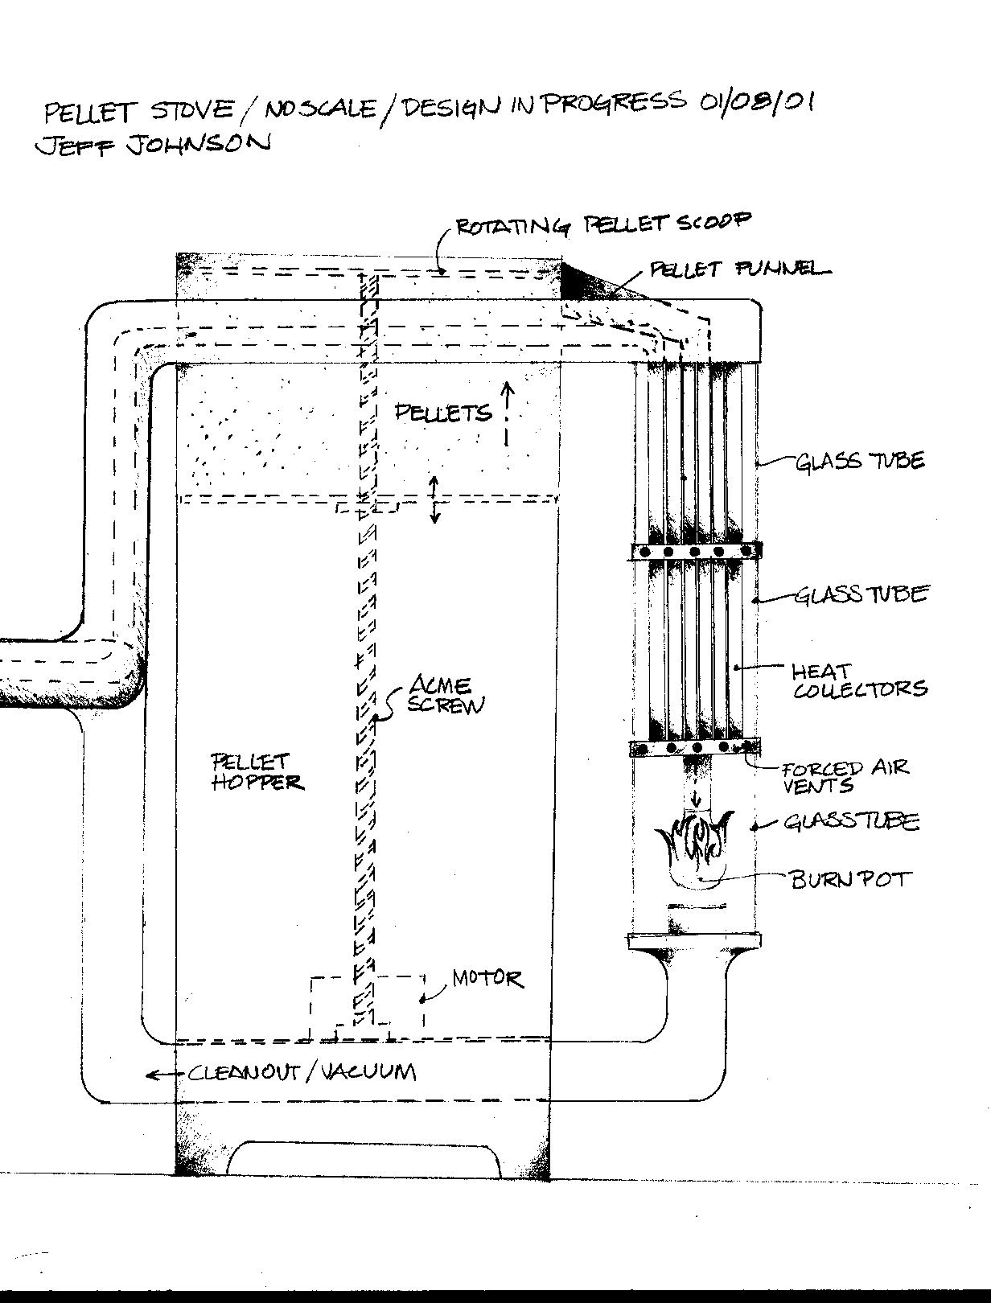
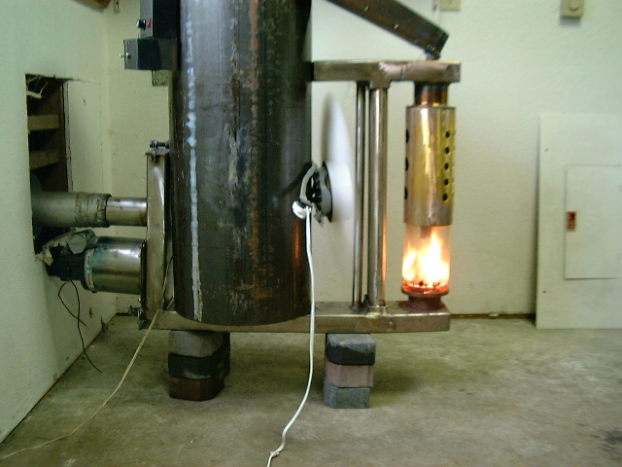
Original Design Concept and First Prototype

Slide 3
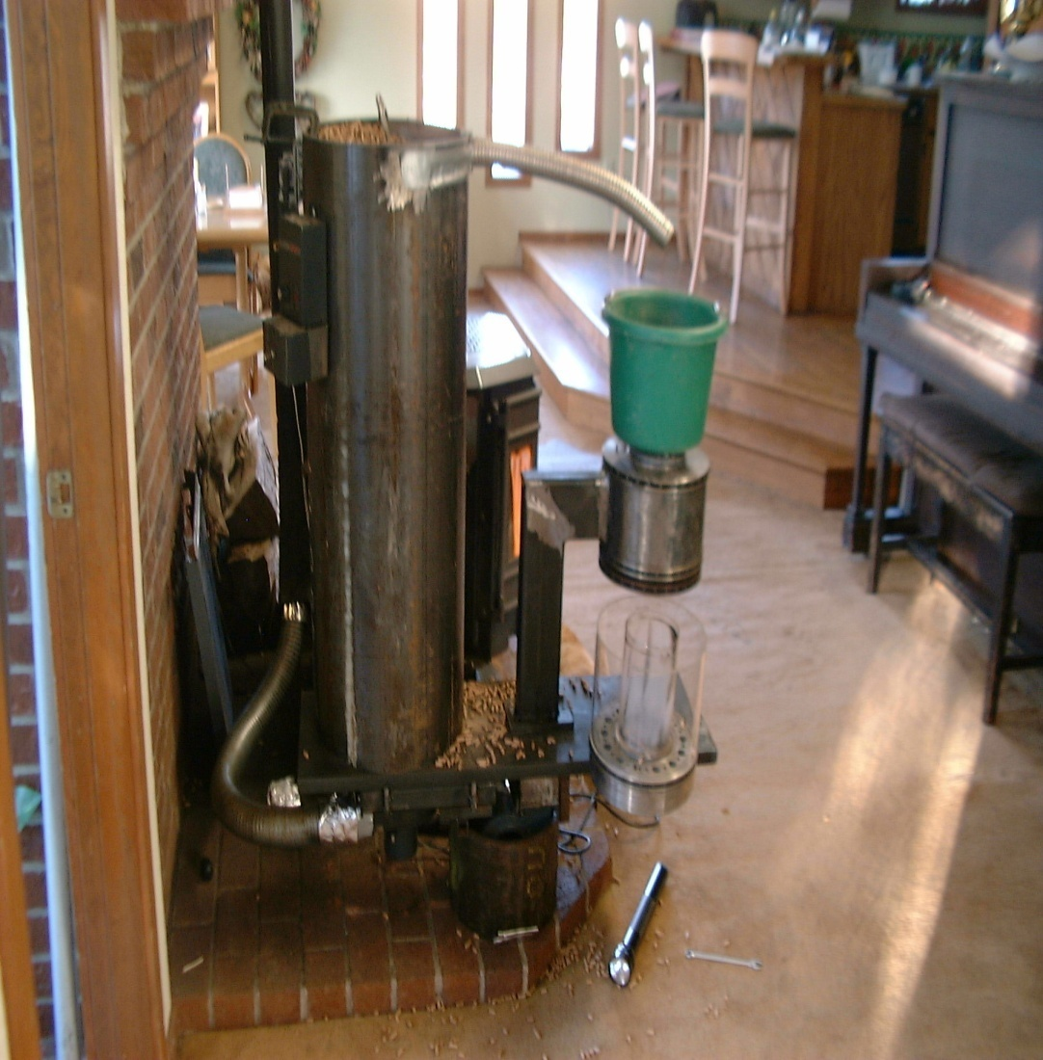
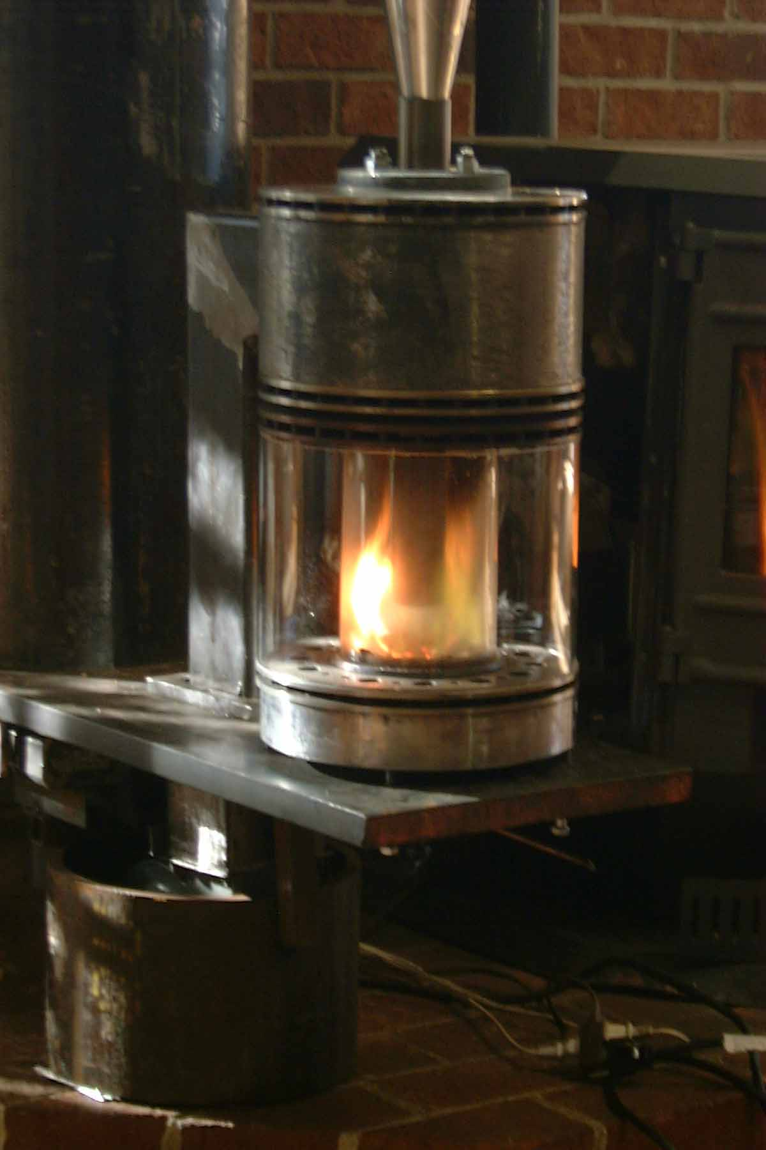
Combustion Chamber Development

Slide 4
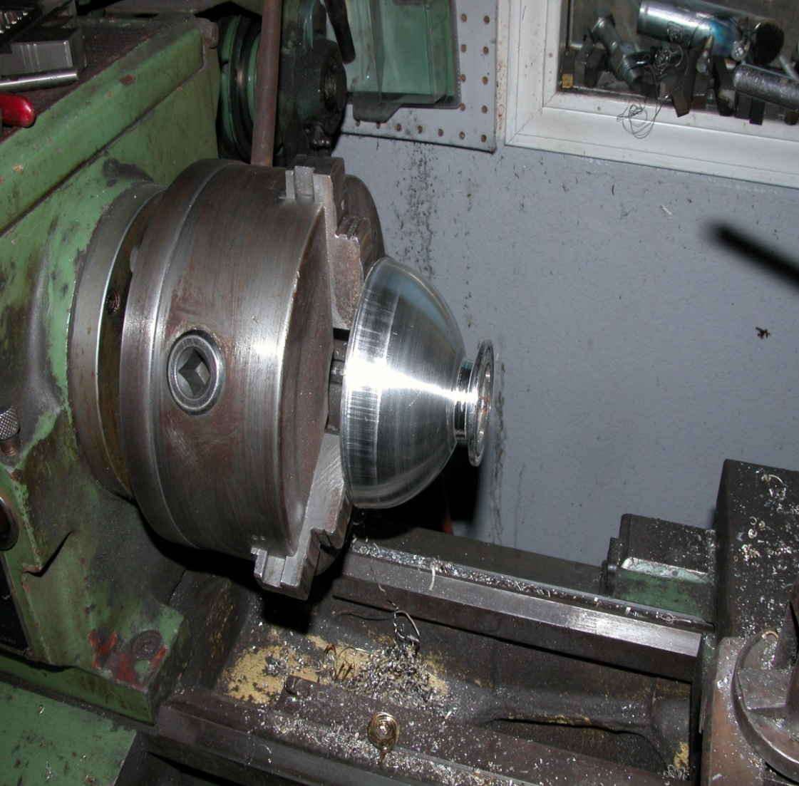
Combustion Chamber Design Study

Slide 5
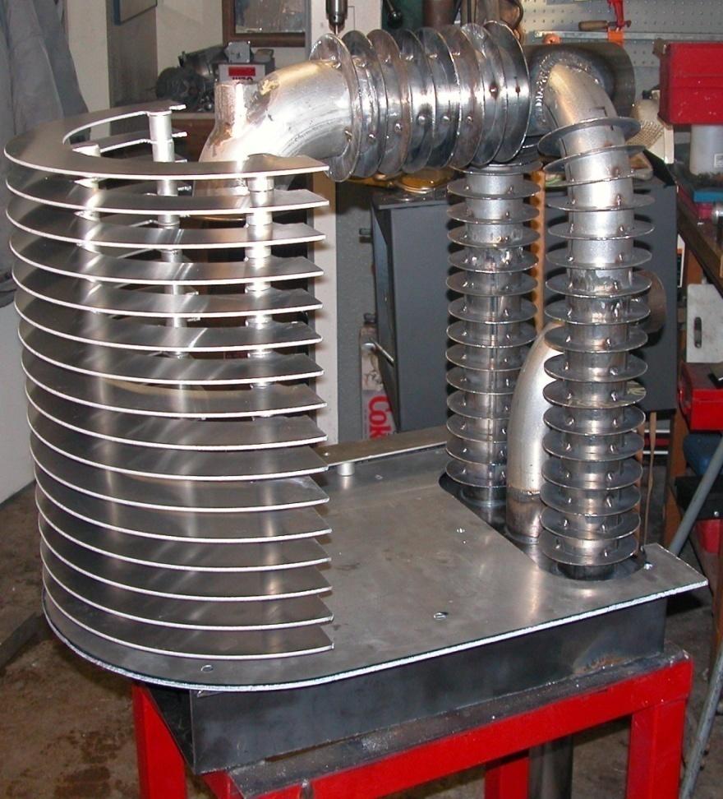
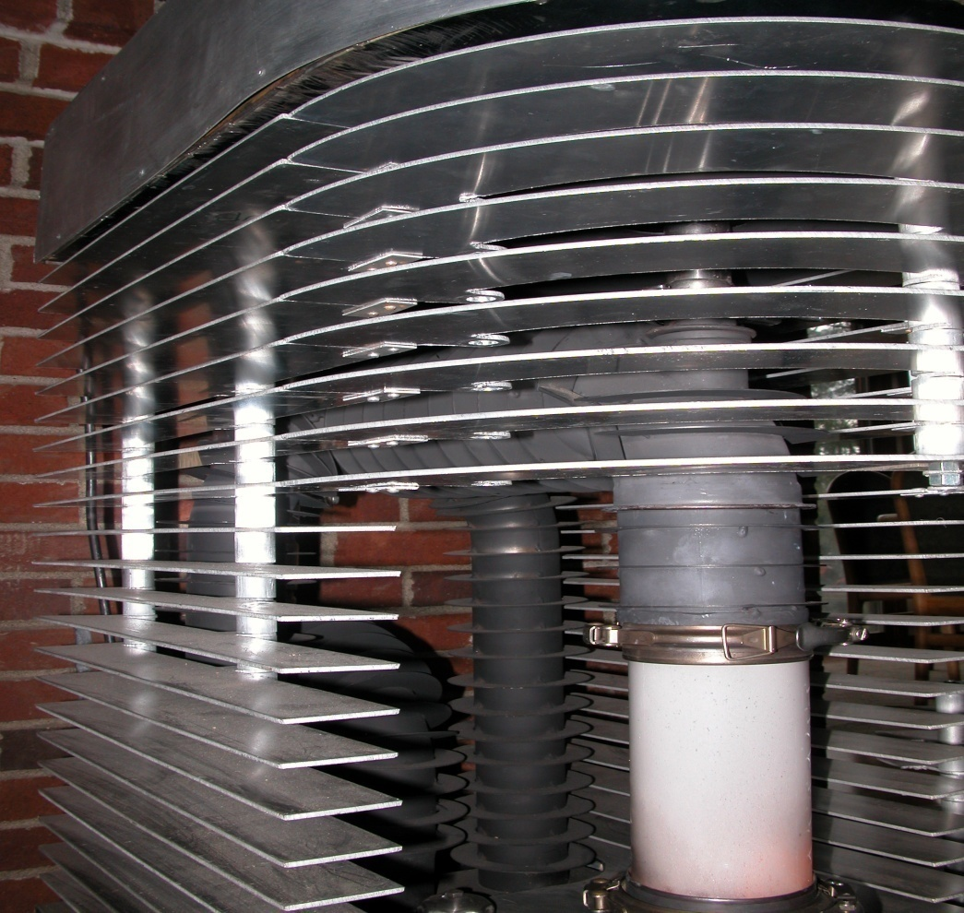
Heat Exchanger Prototype

Slide 6
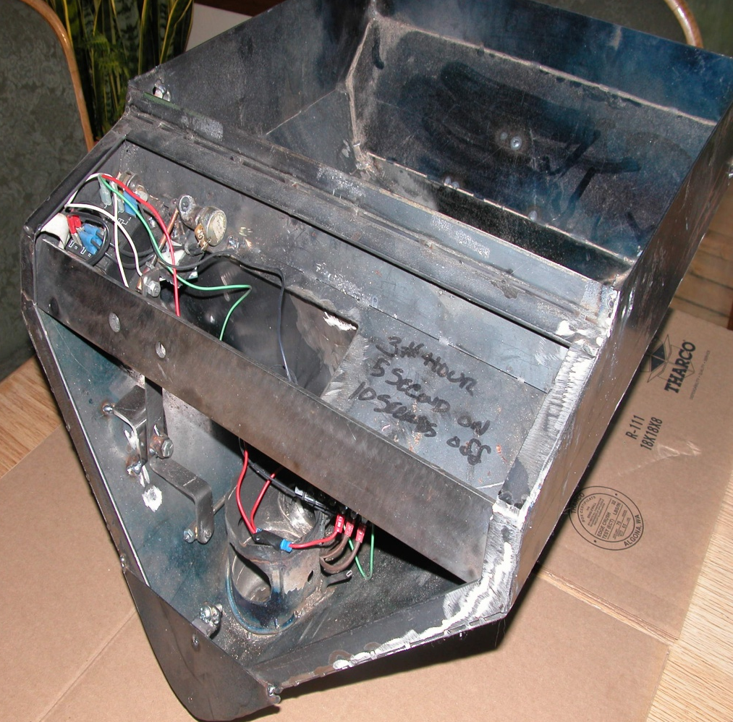
Pellet Hopper Design

Slide 7
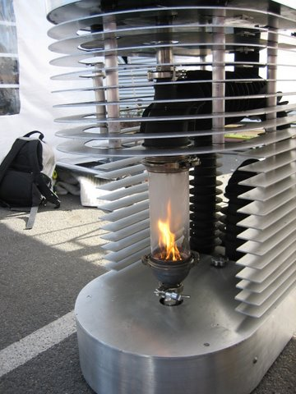
SNQ-1 Prototype @ HPBA Show

Slide 8
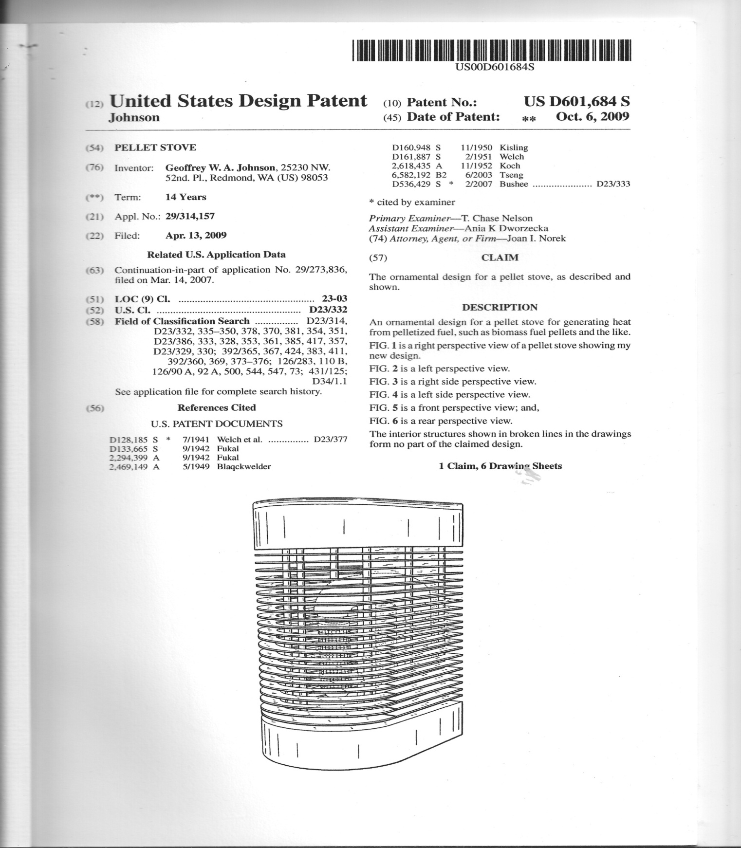
Stove Design Patent D601.684 S

Slide 9
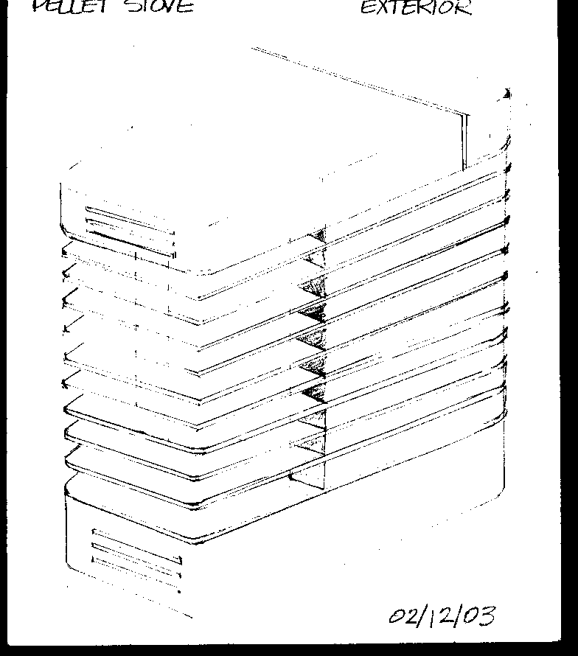
Exterior Design Study

Slide 10
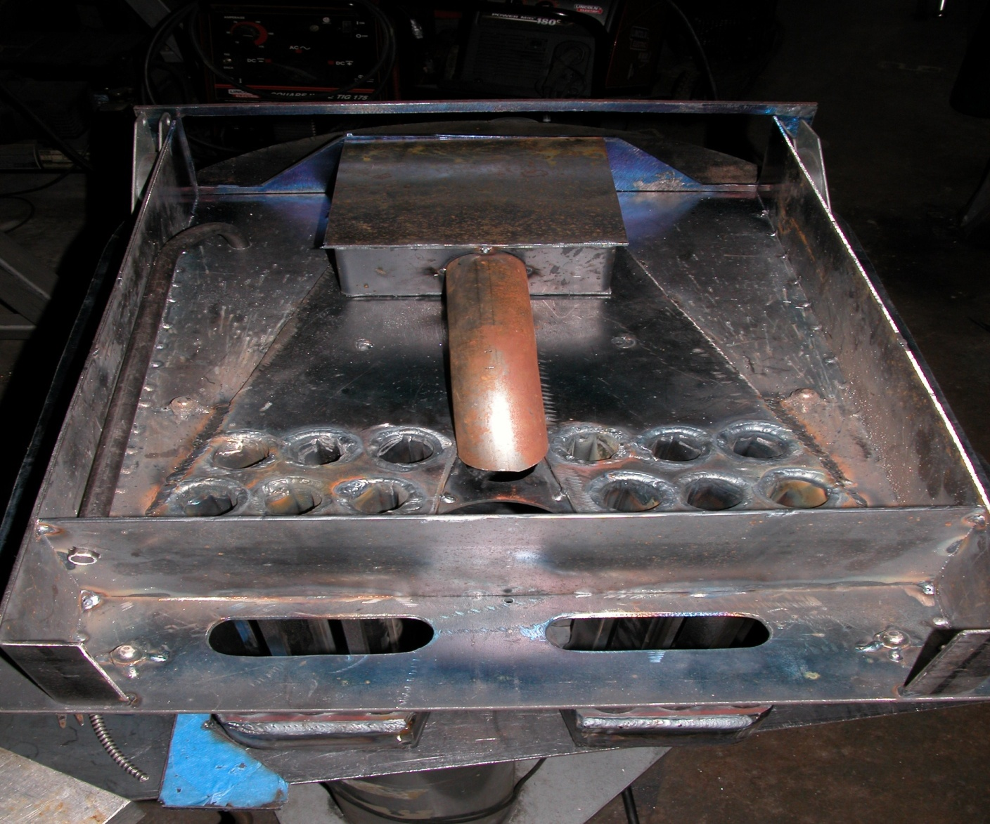
Ash Box Prototype

Slide 11
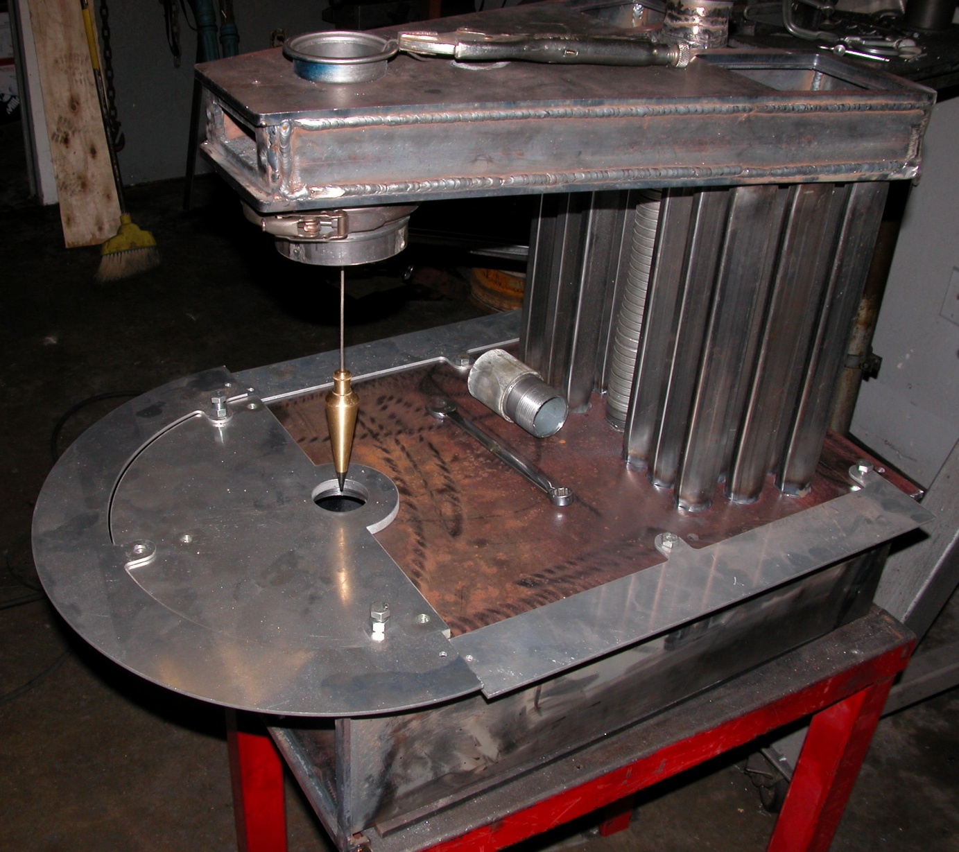
Heat Exchanger Prototype

Slide 12
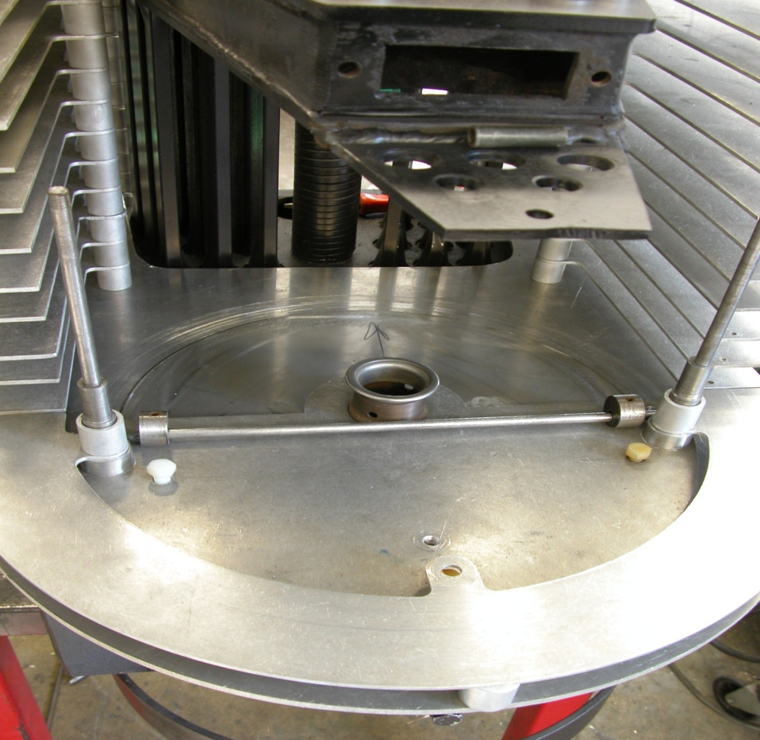
Exterior Trim Prototype

Slide 13
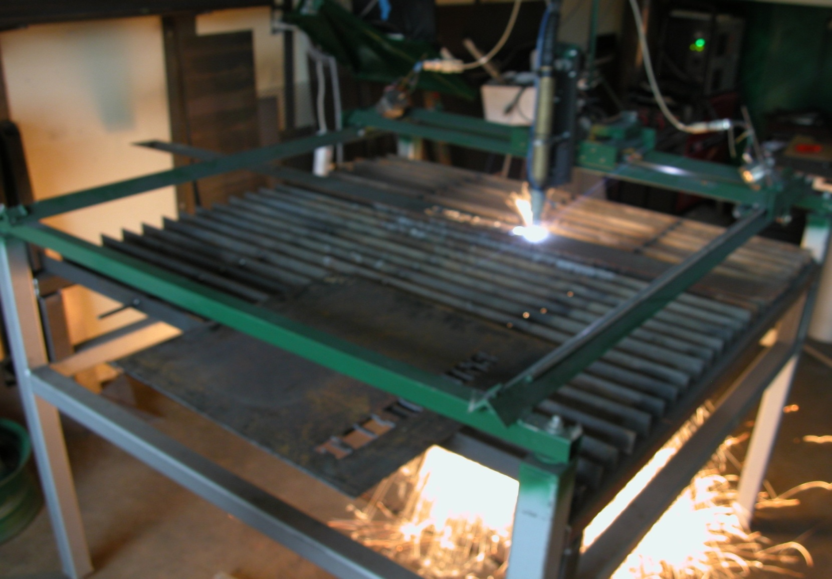
Experimental Plasma Table

Slide 14
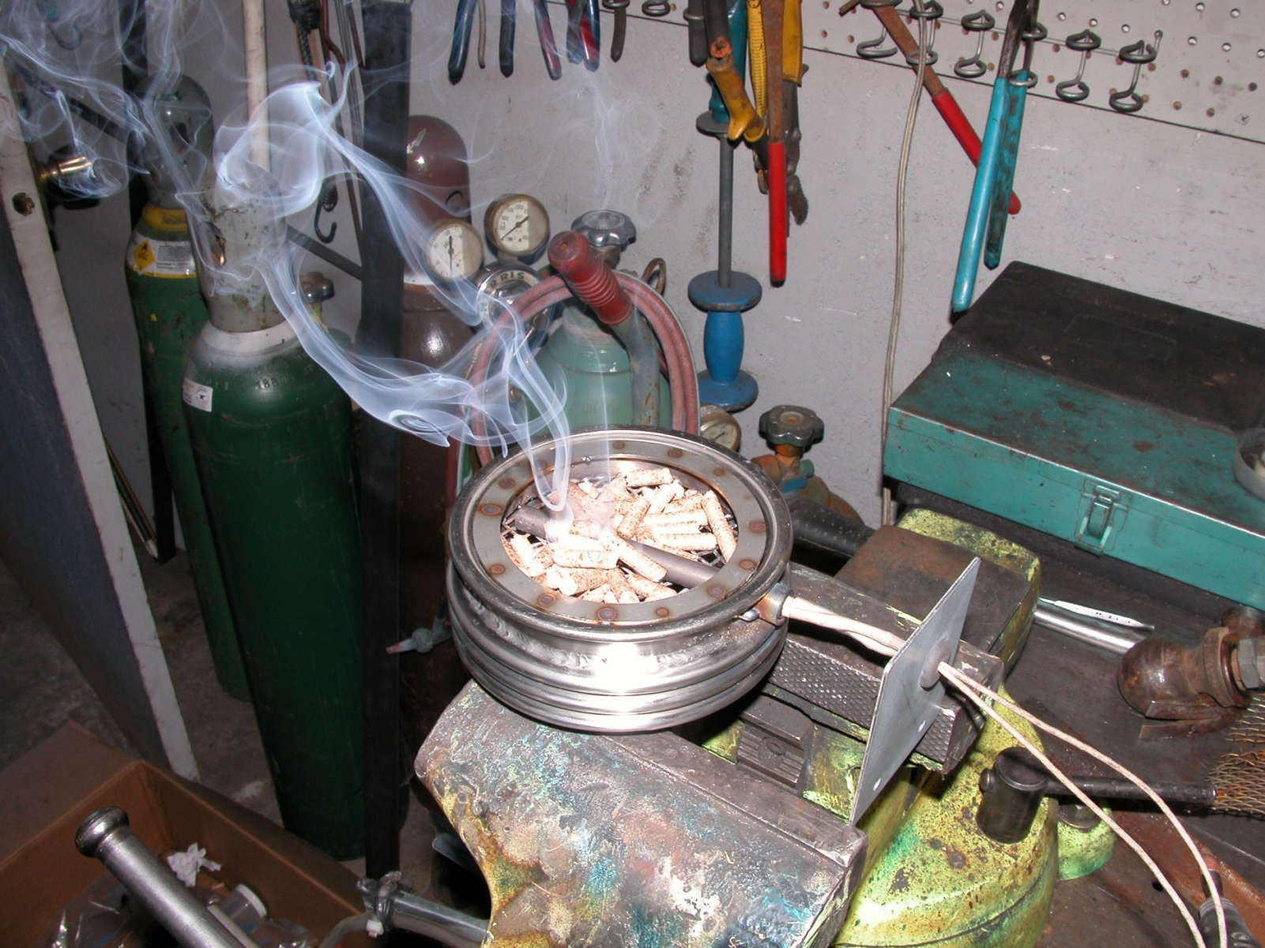
Prototype Ignition System

Slide 15
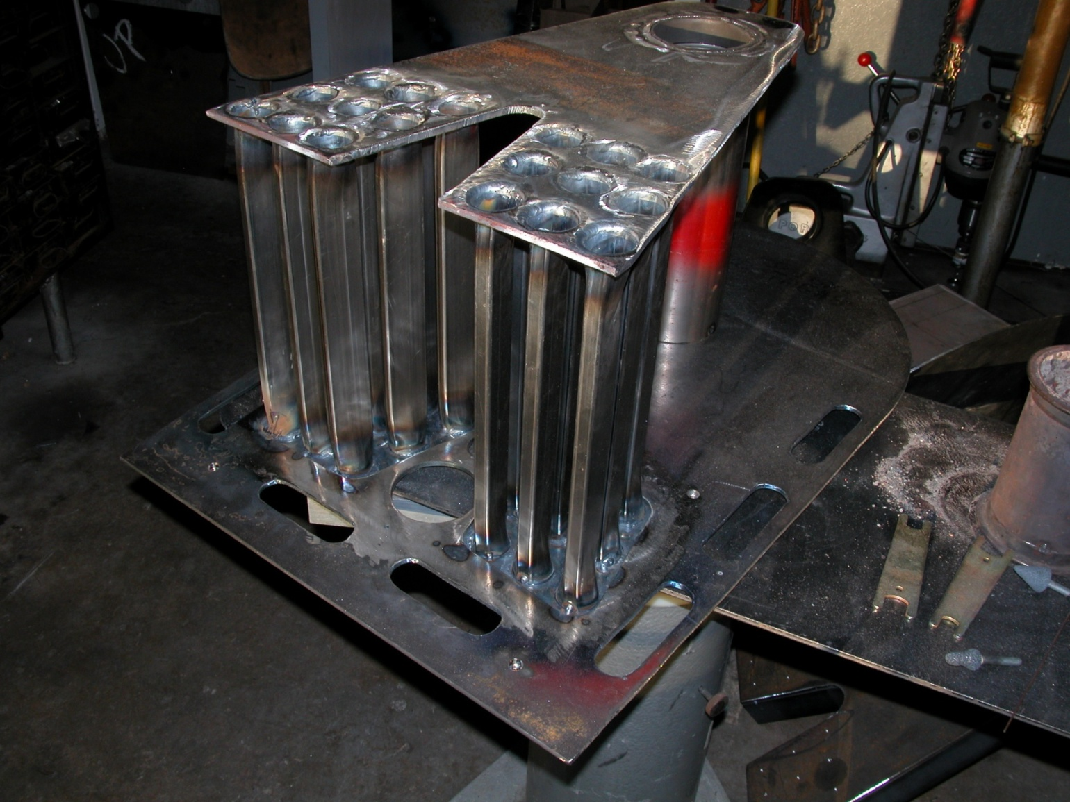
Heat Exchanger Prototype

Slide 16
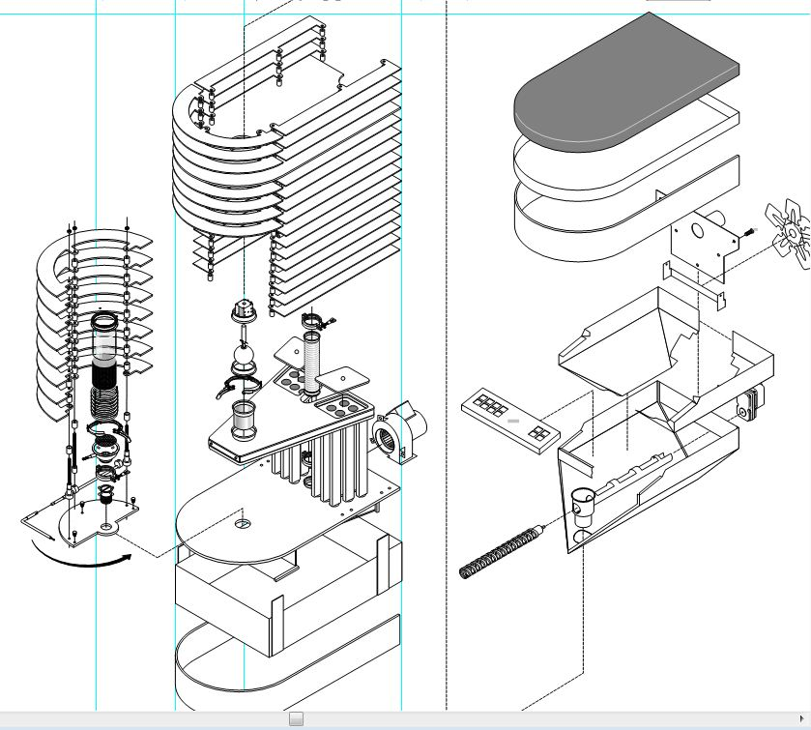
Exploded View

Slide 17
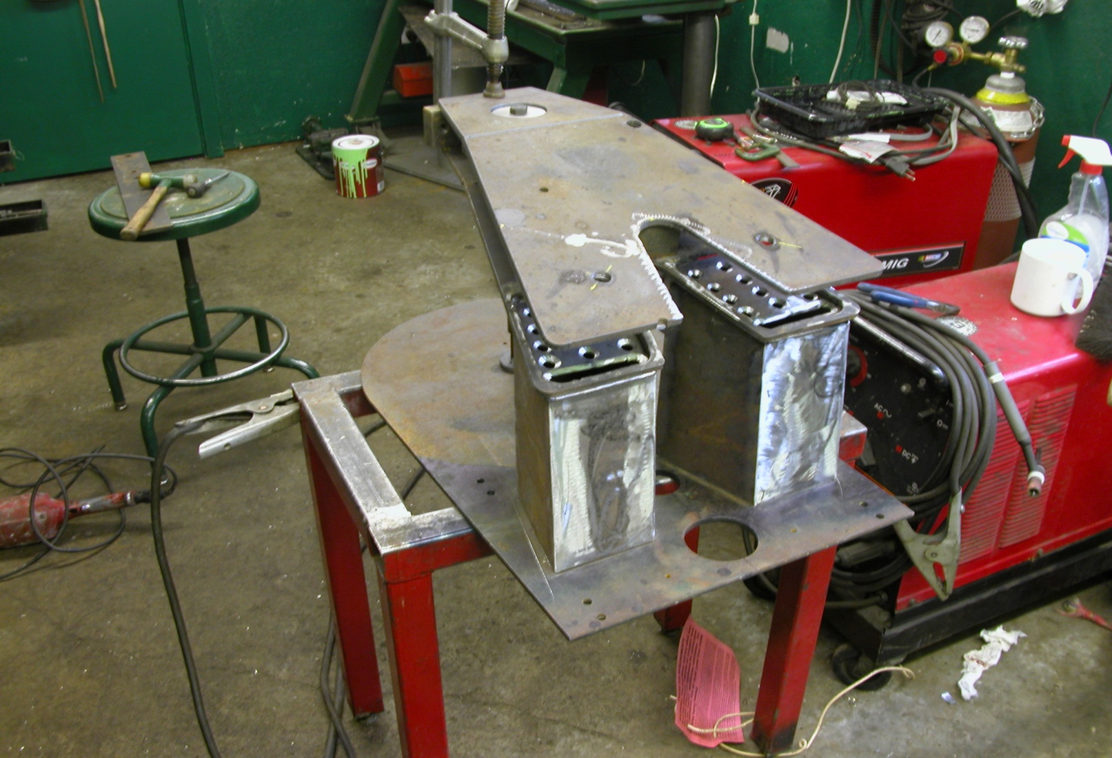
Torrefire Prototype .01

Slide 18
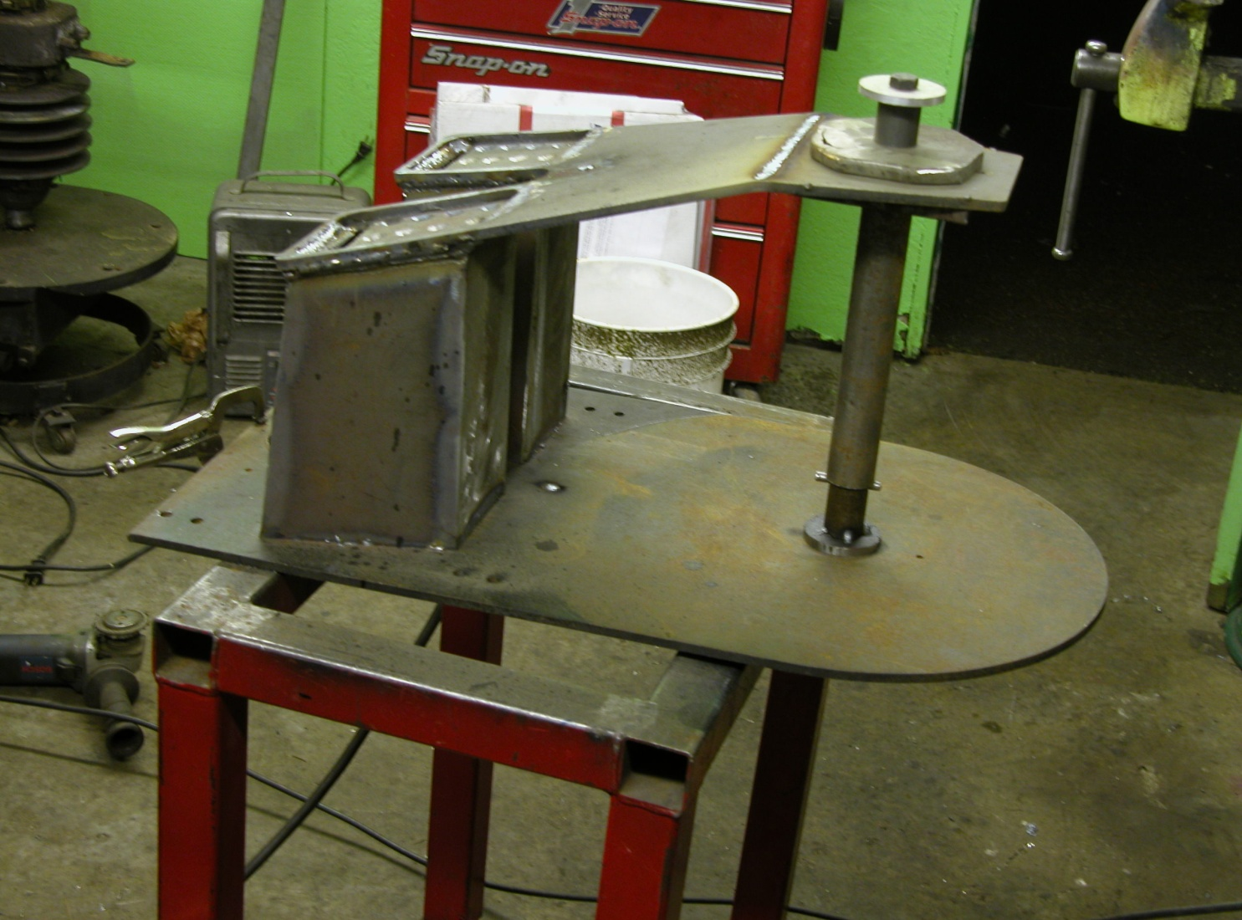
Torrefire Prototype .01

Slide 19
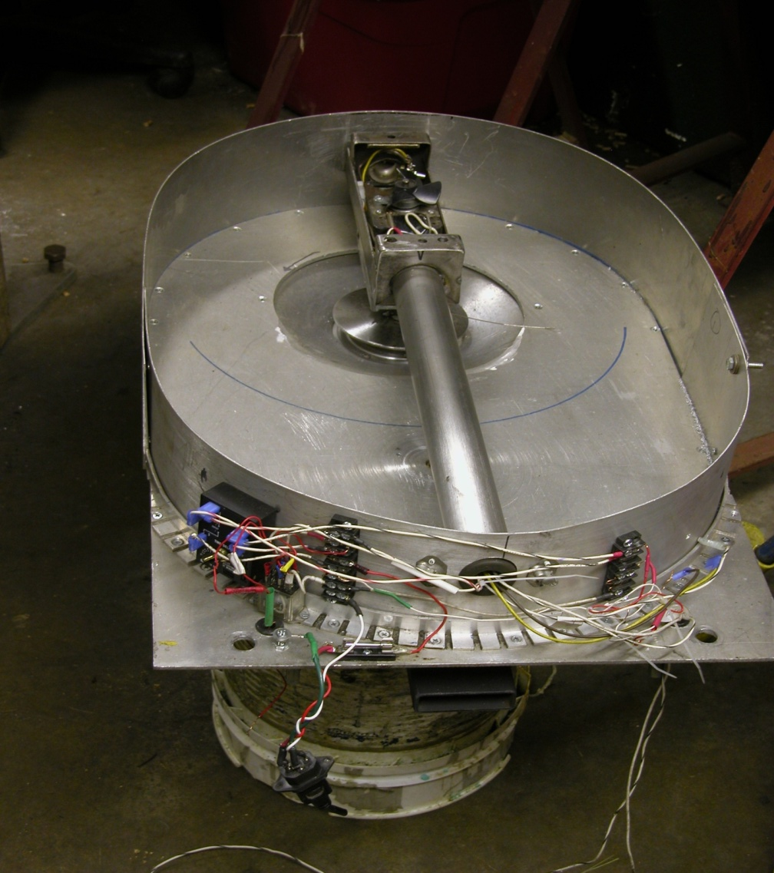
Torrefire Hopper Prototype .01

Slide 20
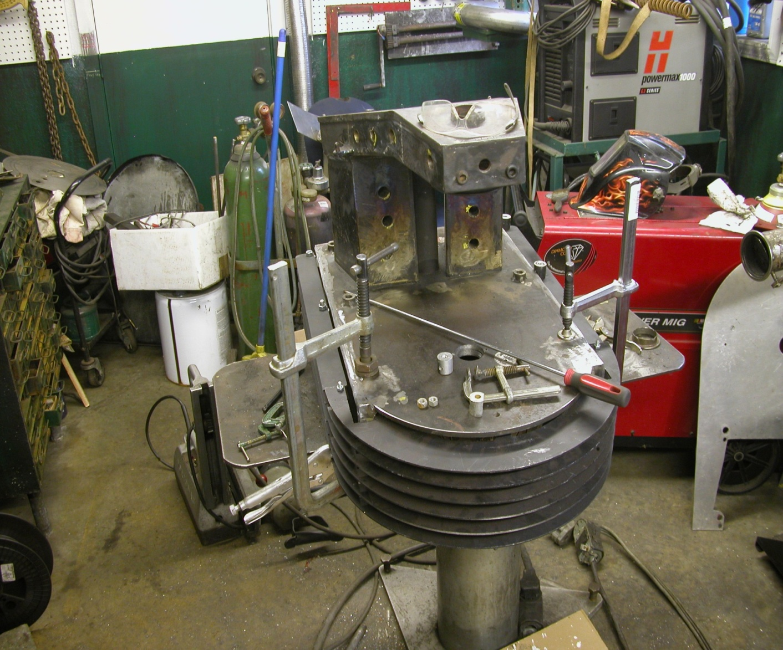
Torrefire Heat Exchanger

Slide 21
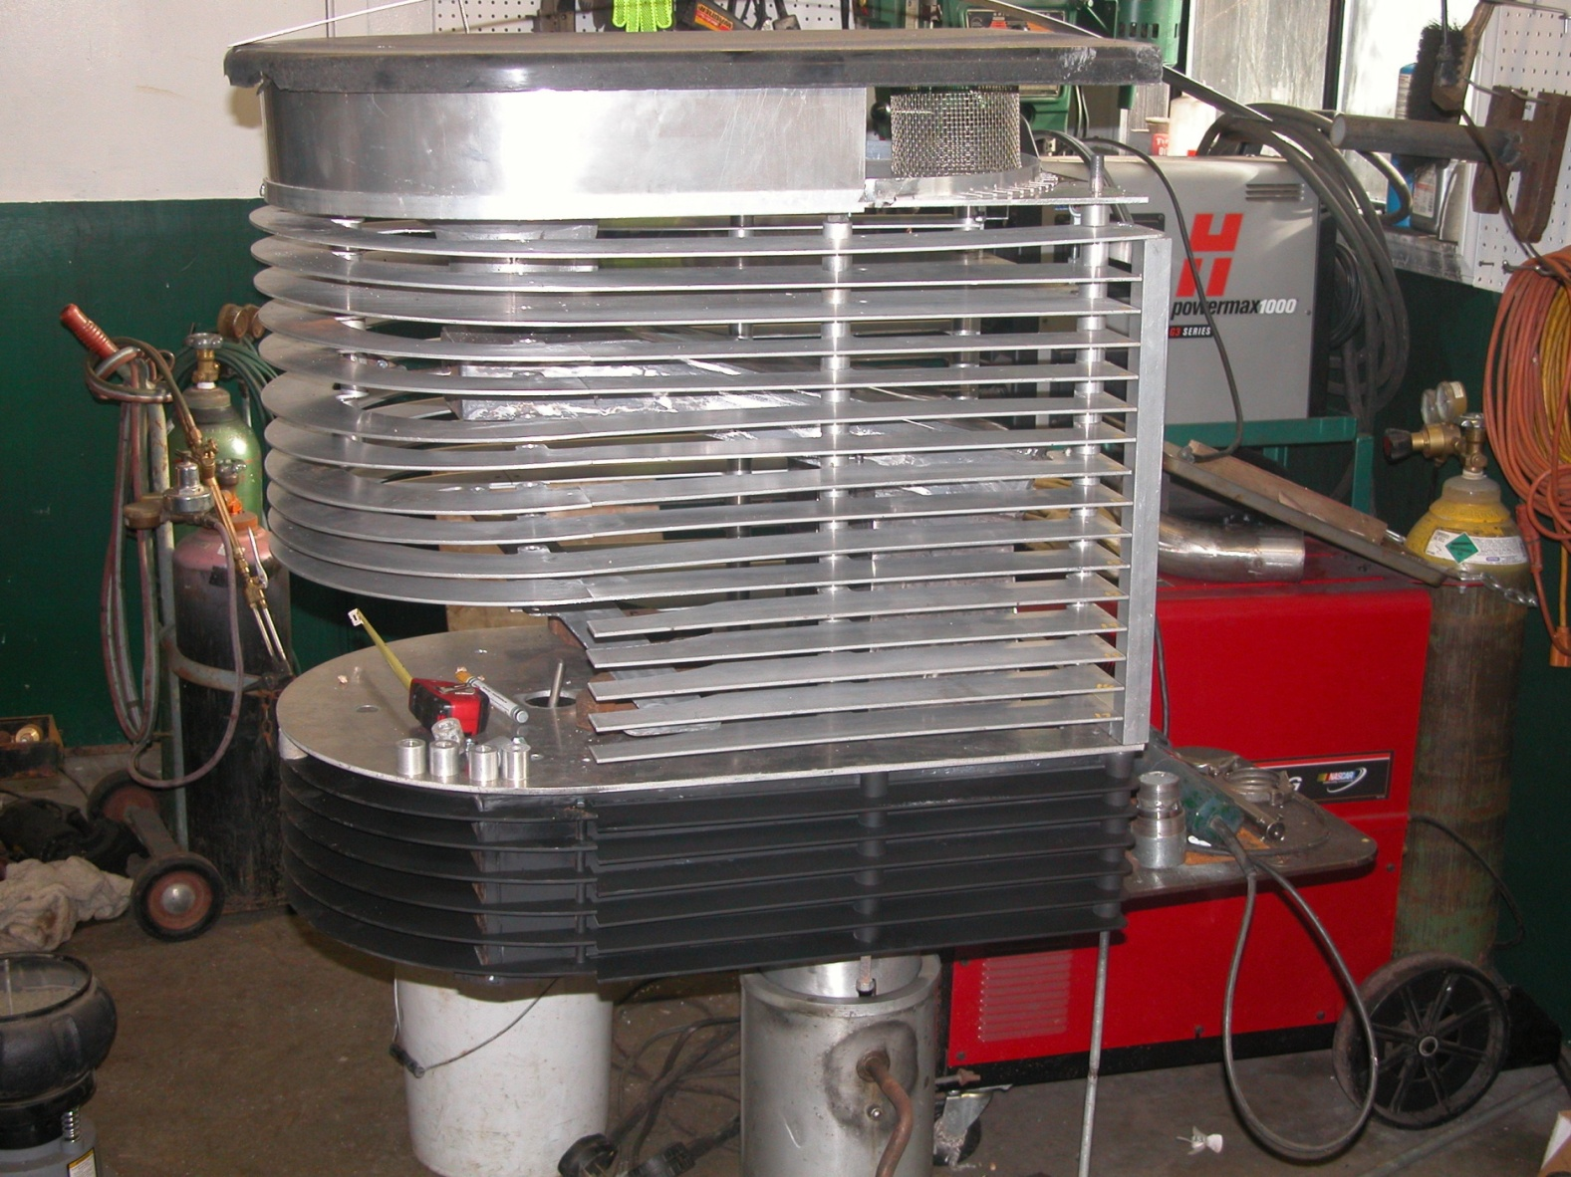
Torrefire Exterior Trim

Slide 22
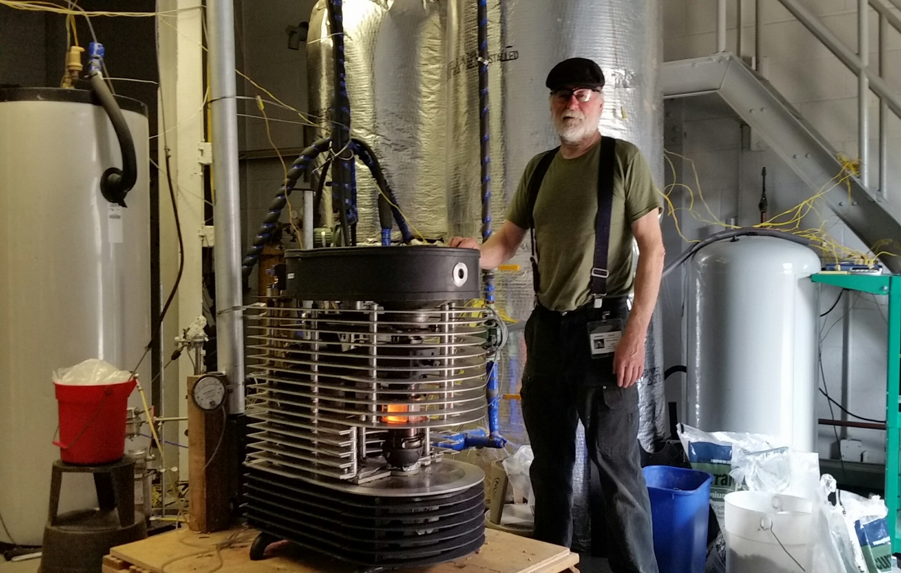
Testing @ BNL

