Slide 1
Biomass stoves in dwellings: interplays between fuel use & technology
pellet stove design challenge 2016
brookhaven, new york, usa
*Ricardo L. Carvalho^{1,2}, Ole M. Jensen¹, Luís A. Tarelho², Estela D. Vicente²
¹Department of Energy and Environment, SBi, Aalborg University, Denmark
²Department of Environment & Planning, CESAM, Aveiro University, Portugal
Notes:
Bringing stories around the Europe…

Slide 2
Biomass stoves in dwellings: interplay between fuel use and technology
Solid-fuel use & air pollution
Traditional installations & certified appliances
Comparing two contexts
Performance: retrofits & automation
Advanced interventions
Outcomes

Slide 3
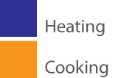
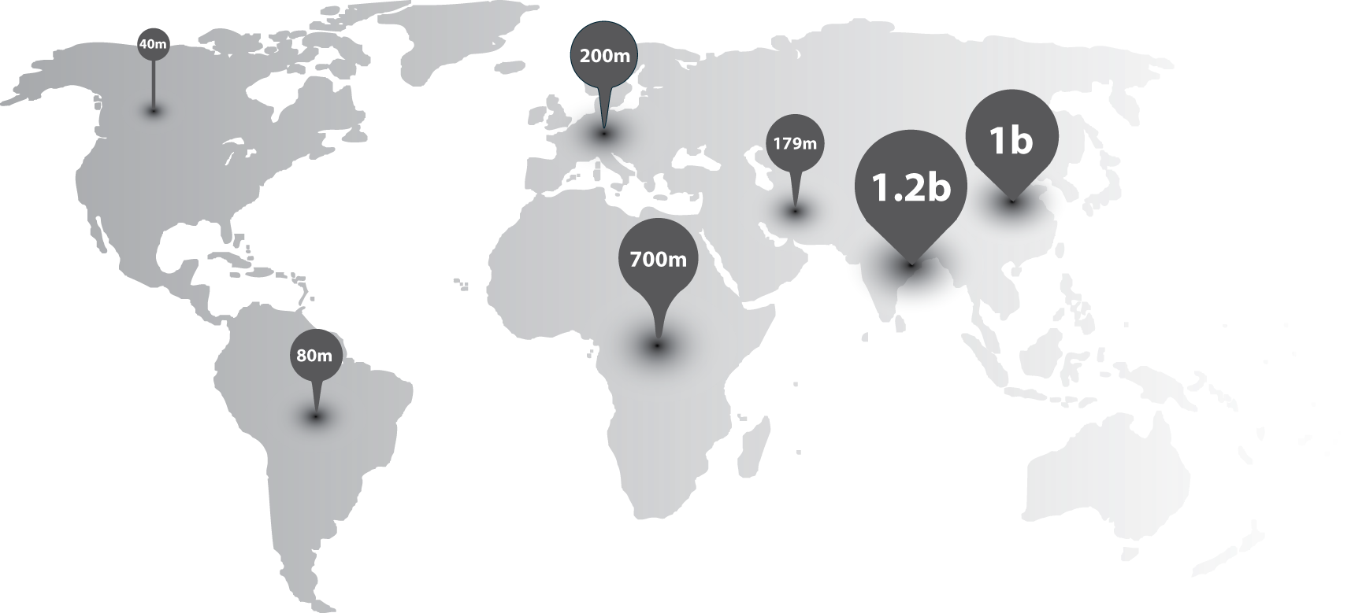
Solid-fuel use & air pollution
Residential wood heating is a major source of PM in Europe
In cold areas, heating requires more fuel than cooking during atmospheric inversions!
Notes:
Outdoor air pollution is a major risk factor – responsible for 3.3 million permature deaths from PM2.5 associated to residential energy use in India and China (GBD, 2010)

Slide 4
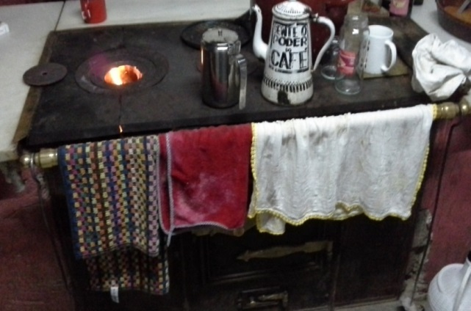
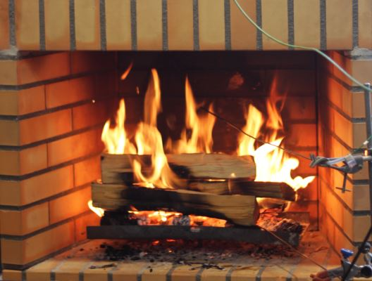
Traditional installations & certified appliances
© Carvalho,2013
Heating and cooking using wood/coal in Spain, Galician cast-iron stove, 2013
Recreational wood heat in Europe
Open fire, 2016
Notes:
Direct wood heaters dominate LOT15 stock ~ 65 Mo
e.g. Fireplaces (16 Mo)
e.g. Enclosed (>7 Mo)

Slide 5
Traditional (22 Mo) & certified appliances (41 Mo)
© Carvalho,2013
Rural Areas
Mediterranean
High loads
2-4 kg/h
Primary Mediterranean High loads
EN ecolabel Portugal
© Solzaima,2016
Heating and cooking in Spain,
Galician cast-iron stove, 2013
Heating winter in Spain. Portugal
Insert, 2016
Secondary Nordic
Low loads
All over Europe
Wide range loads
1-6 kg/h
Ecolabel swan
Recreational wood heat in Europe
Open fire, 2014
Heating and cosiness , winter in Denmark, 2014
Notes:
e.g. Certified inserts >16 Mo
e.g. Certified roomheaters >25 Mo

Slide 6
Comparing two contexts
Portugal
~1.5 Mo installations
Denmark
~0.7 Mo installations
35.342 TJ/primary heat
31.190 TJ/secondary heat
~30% pellet boilers/stoves!
11 kt PM2.5
17 kt PM2.5
C. Gonçalves et al. Inventory of fine particulate organic compound emissions from residential wood combustion in Portugal. Atmospheric Environment, 50, 297-306, 2012.
Danish Centre for Energy and Environment, 2013.

Slide 7
Performance: retrofits & automation Simulating real-world emissions
Ecodesign requirements,
ANNEX III; 4.a (2)
Ecodesign requirements,
ANNEX III; 4.a (3)
12Pa
Natural draft
(2) Dilution tunnel at Univ. of Aveiro
Dilution rate/25-35
Portugal, 2015
(3) Dilut. tunnel in a testing setting (NS3058)
Denmark, 2010
© Carvalho,2014

Slide 8
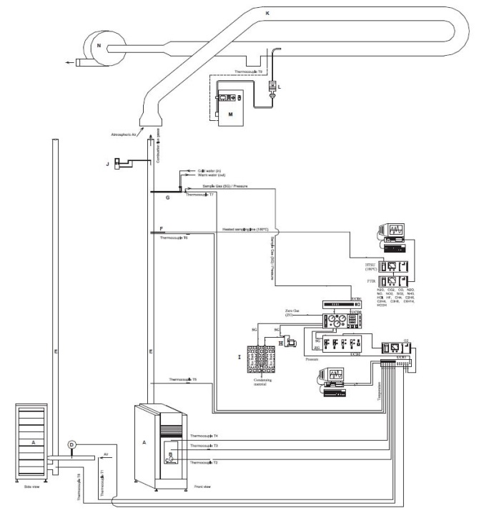
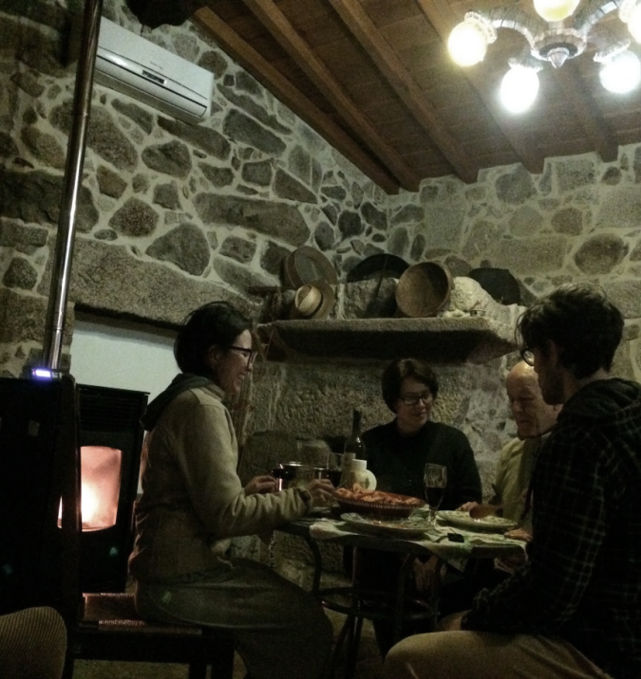
Performance: retrofits & automation Laboratory & field studies
Laboratory tests
3 installations
Iberic rural house
Pellet stove (EN14785:2008), 2016
TCR/Tecora
6ms-1/2.3 m3/h
Pitot
Testo 512
FTIR
Gasmet
CX4000
Flow meter
Kurz 155
Gaseous (mg/Nm3) 13% O₂
Particulate (g/kgF) emissions
Thermal efficiency (%)
Wattage output (kW)
© Tarelho, 2015
Notes:
Ftir = fourier transform infrared analyzer
1- Moisture/Ash (CE N14774/5;EN14961-2)
2-Elemental analysis
(external lab)

Slide 9
Performance: retrofits Operation of wood stove (B) & heat recovery
Stove B
B+Chimney pre-heating

Slide 10
Performance: retrofits & automation Gaseous (CO and TOCs) emissions (N=3)
The European Comission, “Implementing Directive 2009/125/EC of the European Parliament and of the Council with regard to ecodesign requirements for solid fuel local space heaters,” Off. J. Eur. Union, pp. 1–19, 2015. ANNEX II

Slide 11
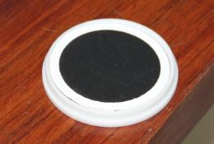
Performance: automation Thermal efficiency and PM emissions (N=3)
More inorganic matter…
E. D. Vicente, M. A. Duarte, L. A. C. Tarelho et al, “Particulate and gaseous emissions from the combustion of different biofuels in a pellet stove,” Atmos. Environ., vol. 120, pp. 15–27, 2015.

Slide 12
Advanced interventions Field investigations
CO, TVOCs
variations
Particles
size ranges
PM2.5
temp/RH
CPC/temp-RH (UFP)
variations outdoors
CPC/temp-RH (UFP)
variations indoors
Low energy house in Oslo, Norway
Foto by Barbosa, 2014
R. L. Carvalho et al, “Wood-burning stoves in low-carbon dwellings,” Energy Build., vol. 59, pp. 244–251, 2013.

Slide 13
Advanced interventions
Emerging devices
Aduro smart response, Denmark
Hwam auto-pilot, Denmark
Manual
Digital

Slide 14
Advanced interventions Overheating & energy savings
>50% supply
Primary heat!
Overheat
Overheat
Smart control
Smart control
Manual
Area~120-400 m²
ca. intake out
Old
New

Slide 15
Advanced interventions
”Draft design” & variations on IAQ
IAQ
#/cm3
digital
Old chimney &
Indoor intake
manual
New envelope &
Indoor intake
Background
New houses &
Outdoor intakes
Lightning
Time (hours)
Refilling

Slide 16
Outcomes & further work Household wood-heating interplays
TRADITIONAL
”smouldering”
IMPROVED
”burning with flames”
ADVANCED
”ash & oxidative”
High losses
Mid losses/wattage
Low losses/wattage
Eg. Europe
Eg. Southern EU
Eg. Scandinavia
New testing approaches of the actual interplays are recommended to support innovation and air quality management processes…

Slide 17
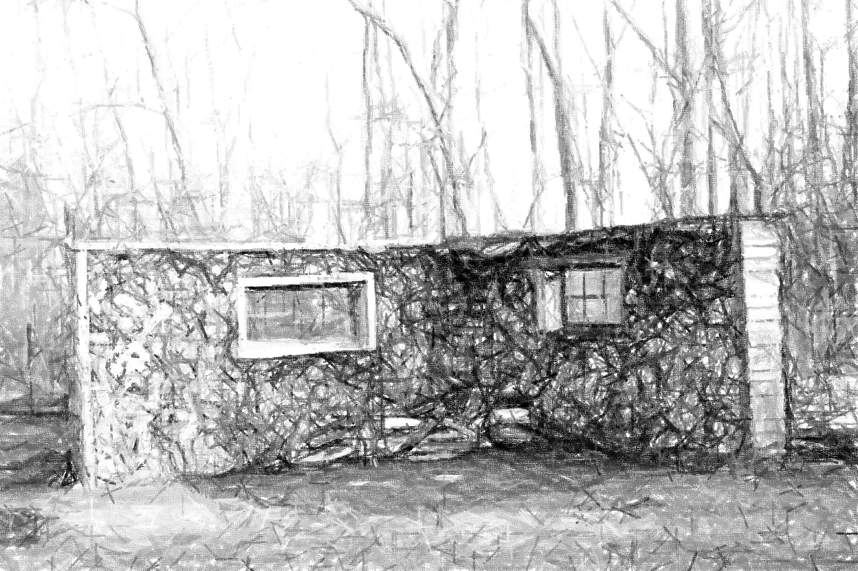
Thanks for listening!
https://woodburningstovesblog.wordpress.com/

