Slide 1
Breakthroughs and Persistent Weaknesses in Pellet Stoves
By Scott Williamson, Pelletstoveservice.com

Slide 2
“Any product that needs a manual to explain it is already broken.” –Elon Musk

Slide 3
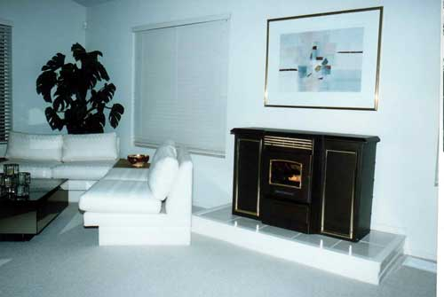
Bottom Feeder
Pellet Master PM5000 1992-96

Slide 4
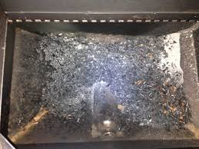
Hopper Fires
The purpose for top feeding stoves was to eliminate burn back. Not so. Still a big problem and it mostly happens to top feeding stoves.

Slide 5
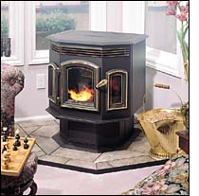
Auto Ignition
1990 Aladdin Hearth Products (Quadrafire) creates the Nova 800 and the 1100 insert. The first pellet stoves to have auto ignition. Auto start allowed the stove to work using a household thermostat. Nearly every stove made now has auto ignition. In the beginning none of them did.

Slide 6
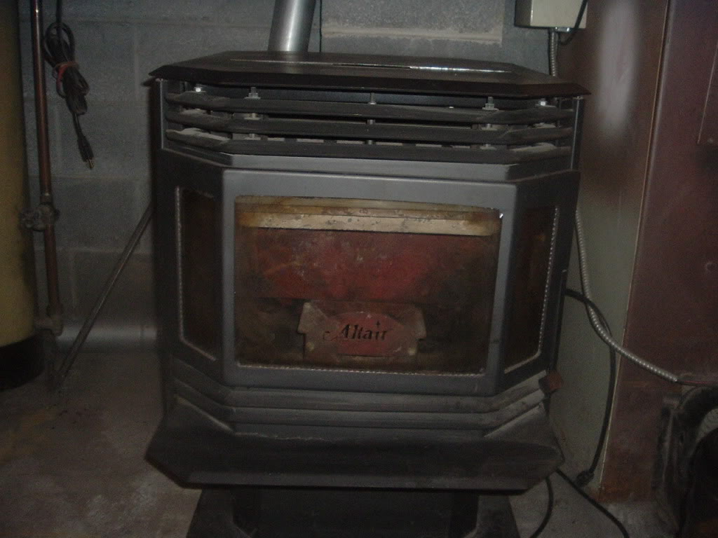
Self Cleaning Heat Exchanger
The Altair company had a clever mechanism attached to the hopper lid.
Each time the hopper opened for refueling it cleaned the heat exchanger.
The factory was accidentally bombed in Kosovo in 1998 by Clinton.

Slide 7
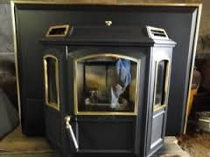
First Insert to “slide” out for service
In the mid-90’s Harman Stove Company created the Invincible Insert, the first pellet stove insert to utilize a stationary rack mounted inside the firebox for the vent and a stove that separated and could slide out for service and a roller service rail was also sold.

Slide 8
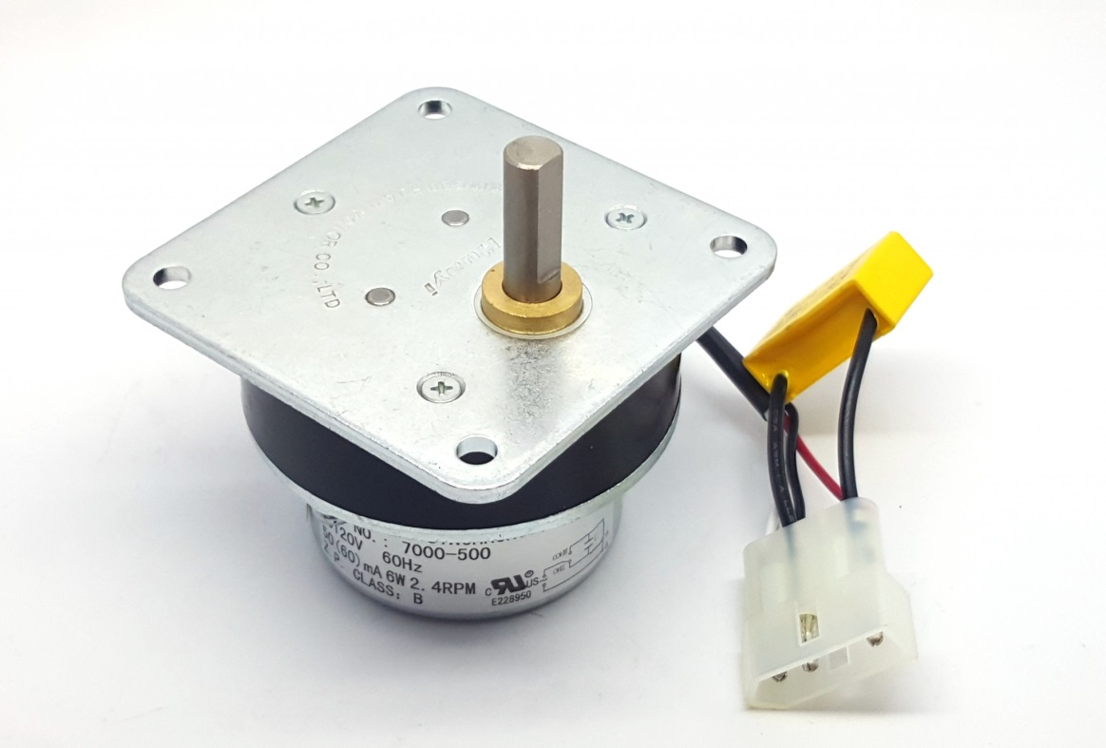
Anti-jam Feeding System
Quadra fire had been using this system since 2000 as well as Rika (Austroflamme) since 2006. The feed motor utilizes a capacitor to flip the polarity or the induction coil motor if the motor become bound up, thus it turns backwards until the capacitor cools and feeding can resume.

Slide 9
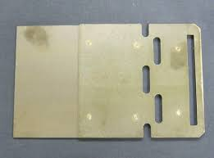
Fines Removed from Hopper
Pellet dust in the hopper is a problem. It’s called fines and unlike the pellets, it doesn’t feed through any stove very well, Harman pellet stoves remove it and store it in a compartment to be removed later.

Slide 10
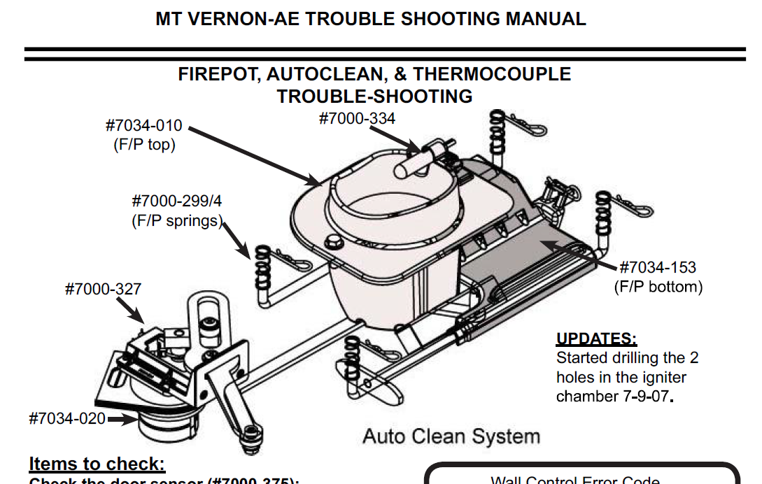
Auto Cleaning Firepot
2006 Quadrafire released the Mt. Vernon AE Stove and Insert that uses a self cleaning mechanism to empty the firepot between each stop and start.

Slide 11
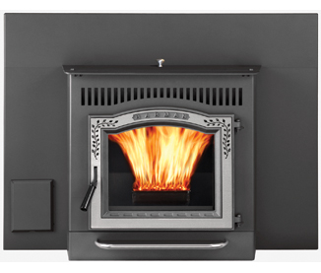
Never Clean Heat Exchanger
In 2010 Harman Stove Company now owned by HHT rolls out it’s first new product under new management. The P35i Insert utilizes an aluminum heat-sink exchanger on the back wall of the refractory so it never needs to be cleaned.

Slide 12
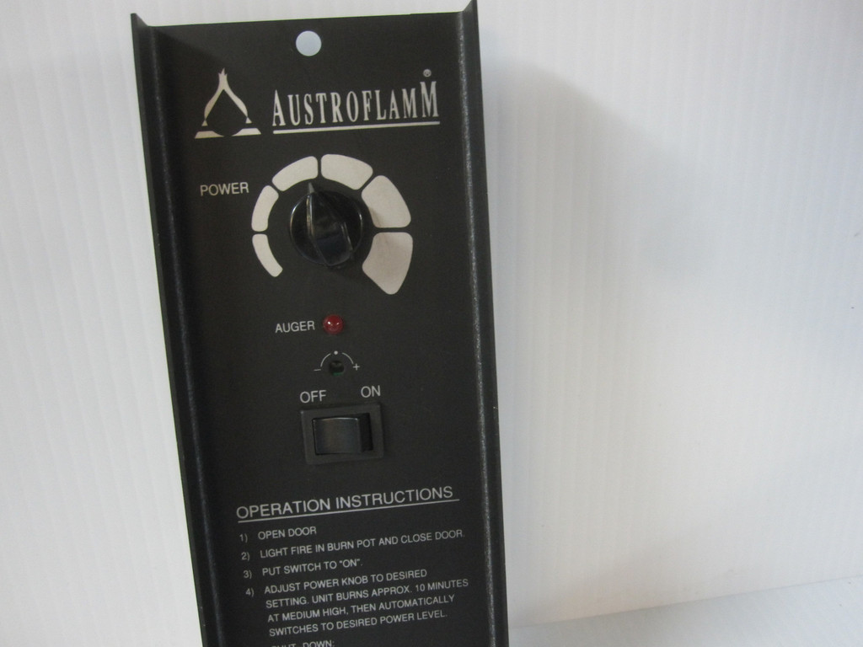
Everyone Understands Switches and Knobs

Slide 13
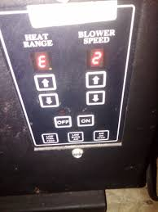
Error Reporting
Digital control boards allow stoves to report what’s going on but they still don’t know why.

Slide 14
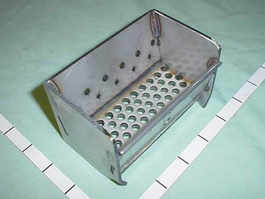
Passive Firepot
Many pellet stove users do not maintain their stoves like they should. Firepots that rely on air movement to keep themselves clean suffer.

Slide 15
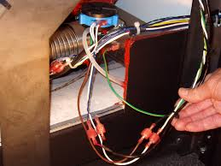
Heat Shielding Components
Insulation wrap not only protects electrical components but also creates a quieter stove while it’s burning.

Slide 16
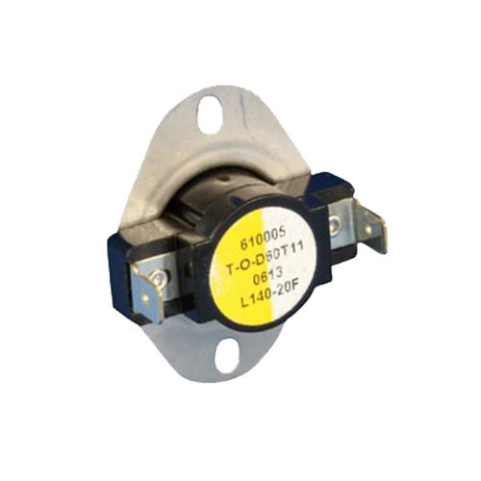
Right Control – Wrong Materials
Plastic switches in the heated exhaust path is a very bad idea yet many still do it.

Slide 17
Questions?

Slide 18
Next Generation Enjoying Warmth Of a Pellet Stove
Jock Gill, Whitfield Biochar
Question – 25 years on, how far has the industry progressed?
How do we restore the sizzle?

Slide 19
Early sizzle
Introduction at 1st tradeshow (Reno 1984) – received requests for >1000 stoves and 50+ dealers wanting to sell pellet stoves
3 years later, September 1987, orders for Whitfield Advantage exceeded $1M in 1 day

Slide 20
A little History
Pellet Stove introduced in 1984 – Whitfield Legend
Original Pellet stove solved yesterday’s problems.
Wood smoke emissions
A more convenient form of wood heating.

Slide 21
1980’s Technology
Continuous variable top feed
Negative pressure combustion
24-hour hopper capacity
Thermostatic control of heat output
Electric Ignitor
Hand removal of ash and cleaning of burn pot/firebox
Requires high quality, low ash, wood pellets

Slide 22
Has technology changed since the original design?
Not substantially
Fuel quality may be worse
Component quality (blowers, motors, controls) may be worse
Efficiency and emissions are much the same
Service levels are still high
Sales are down, pellets and stoves

Slide 23
Our World Today. What’s changed since the ‘80’s?
Deregulation of natural gas
Low Energy prices
Convenience of gas stoves
These are all barriers to growth

Slide 24
Looking forward, can we see opportunities for growth?
Clean Energy is a huge opportunity
We recognize the critical need for processes that remove excess CO2 from the atmosphere
Early days saw wood pellets as a beneficial “carbon neutral” fuel
Today this is not strictly accurate nor does it address the problem fully
Can our industry address the problem, create new markets and put the sizzle back in the pellet stove?
Yes, we can

Slide 25
Move from “carbon neutral” to “carbon negative”
Move from Combustion to Pyrolysis
Pyrolysis provides the opportunity to return 50% of the fuel carbon to the soil permanently, as biochar, for long term reduction in atmospheric CO2

Slide 26
Natural Carbon Cycle

Slide 27
Biochar Pellet Stove
Patent Pending

Slide 28
Efficiency of Pellet Stoves
Dominated by additional “excess air” often 100% - 300%
Agitation of pellets in the burn grate
• Window wash
• Uncontrolled flow through pellet feed system
Improved combustion efficiency with pyrolysis
Premixing of gas and air prior to combustion
Airlock on the pellet feed system limits extra air
Efficiency must be based on caloric value of wood pellets consumed less the caloric value of biochar produced.

Slide 29
Benefits of Pyrolysis
Pyrolysis operates at temperatures below the melting point of ash
Enables the use of low grade/high ash pellet fuels
Opens new markets for low cost pellet fuels, Ag residues, woody wastes etc.
More market opportunities for pellet manufacturers
Creates a marketable co-product, biochar

Slide 30
Biochar -- The Added Value Co-Product
Existing and emerging markets for biochar
Soil amendment for improving plant production in horticulture, forestry, and agriculture
Filter medium displacing higher cost activated charcoal
Land reclamation
Current market values are in the range $400 - $2400 per ton
Value of Biochar can lower the cost of pellet fuel for space heating

Slide 31
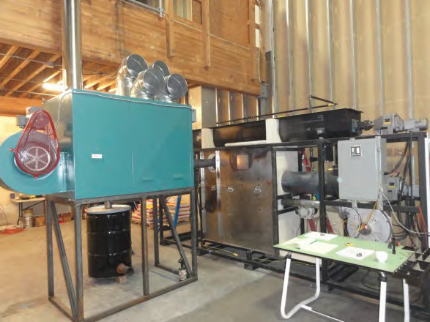
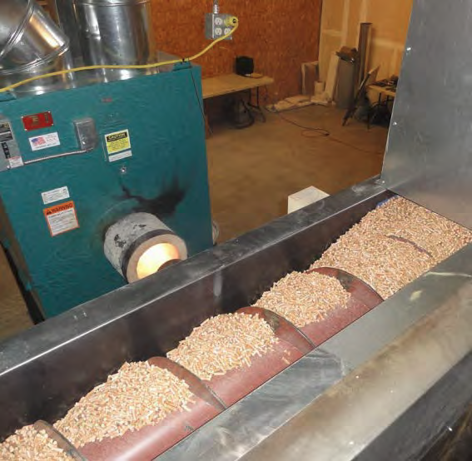
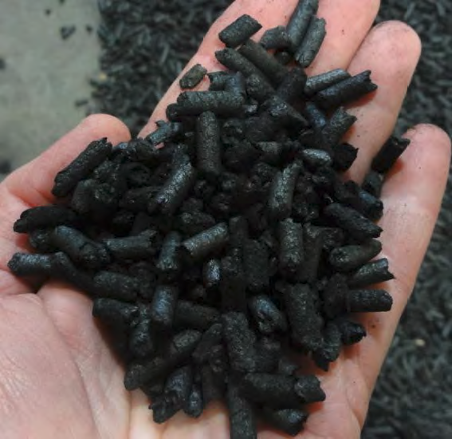
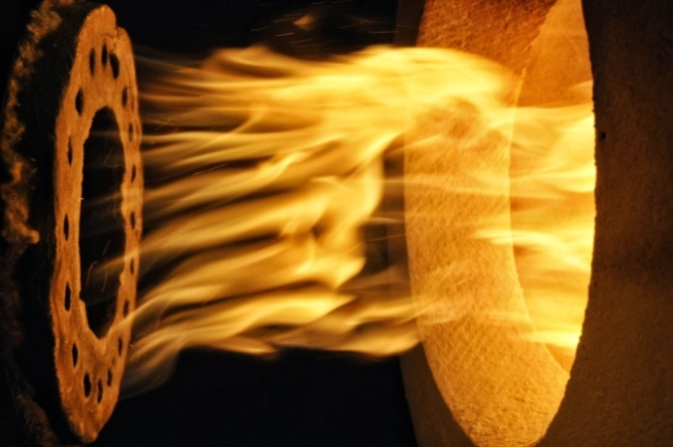
Biochar Reactor Development
Commercial Scale Reactor
Bench Scale Research
Biochar
Renewable Thermal Energy
Pellet Feed

Slide 32
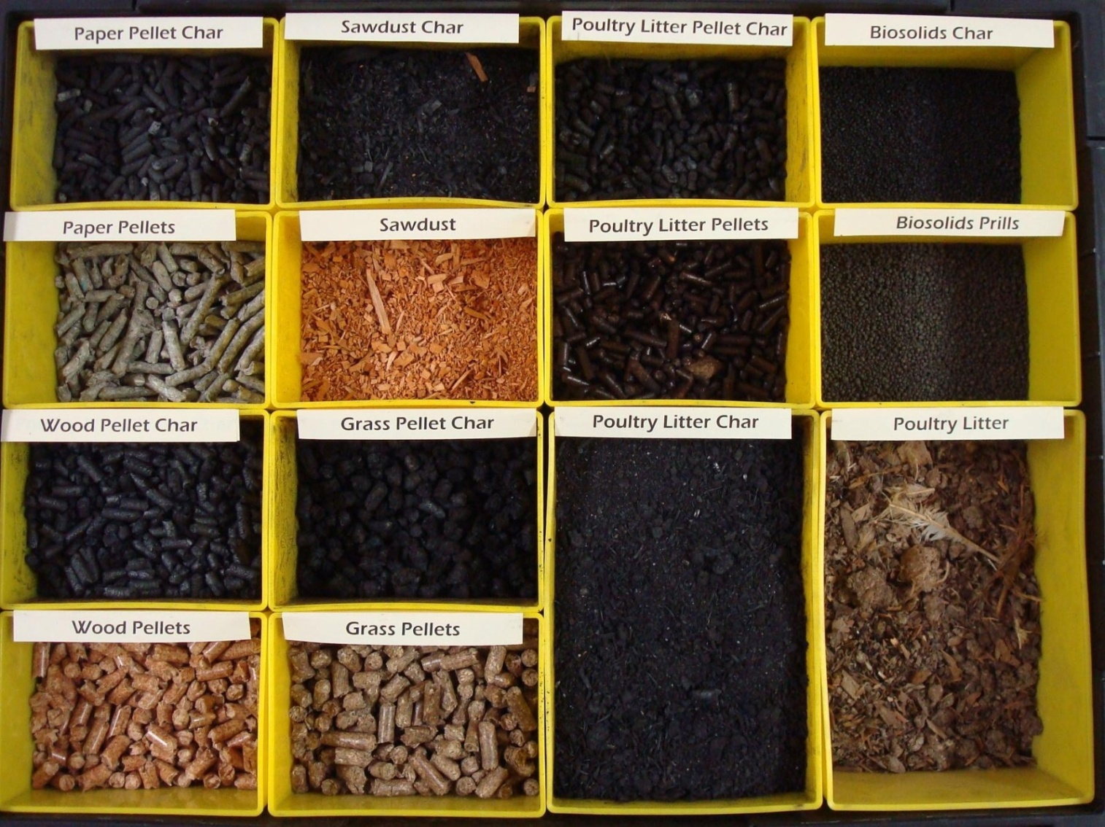
Range of Fuels Tested

Slide 33
Benefits of Biochar Pellet Stove
Wide range of pellet fuels
Lower cost of heating
Improved emissions and efficiency
Reduced ash cleaning
Added value of biochar
Broader market
Simple design

Slide 34
Can This Technology Gain Widespread Traction?
Relatively low risk transition for this industry
Majority of the infrastructure (manufacturing, marketing) already exists
Increases the diversity of feedstocks that can be used
Strengthens the economic and environmental value propositions
Broader market appeal

Slide 35
Lead or Follow?
There is evidence that similar technology is currently under development in Europe
The US was the early leader in the Pellet Industry.
Do we want to regain our leadership position?

Slide 36
Follow On
If you would like to further explore this opportunity or need more information, please contact Jerry at:
jerry.whitfield@gmail.com
cell phone 360 708 0808

Slide 37
Questions?

