Slide 1
EPA Pellet Stoves, The Residential Wood Heater NSPS, and the Burn Wise Program Adam Baumgart-Getz Pellet Stove Design Challenge at Brookhaven National Laboratory – April 6th-8th, 2016

Slide 2
Why Wood Smoke is a Problem

Slide 3
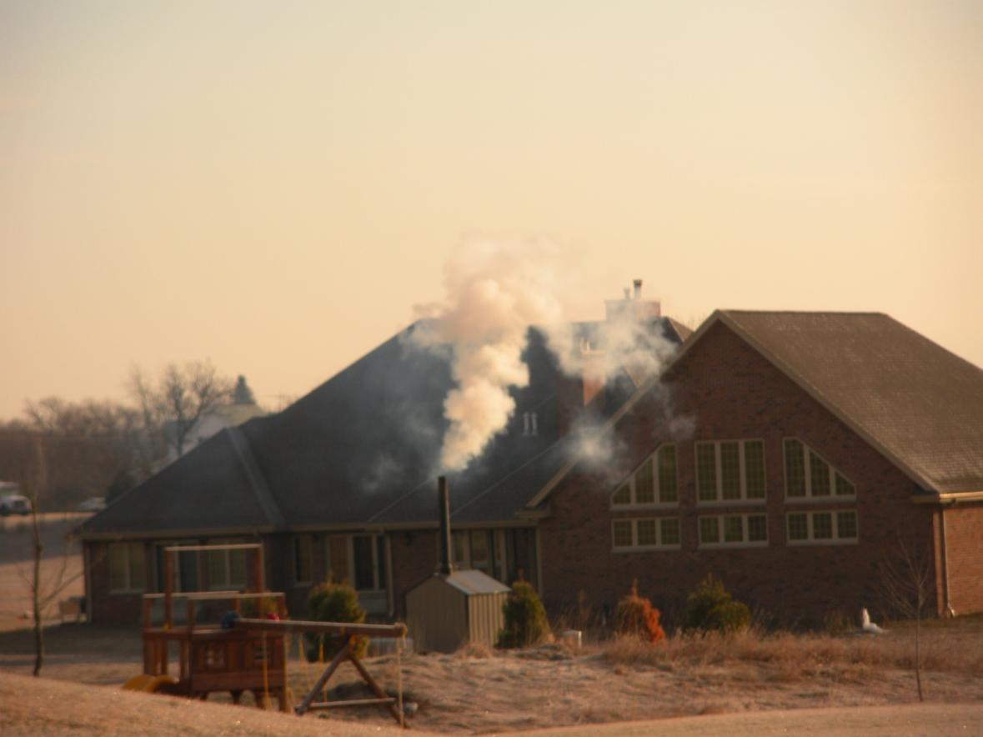
Residential Wood Smoke and Air Toxics Pollutants
Nationally Residential Wood Smoke
Accounts for:
20% of total stationary and mobile
polycyclic organic matter emissions
50% of all area source air toxic cancer risks
Notes:
Data comes from 2011 NATA.

Slide 4
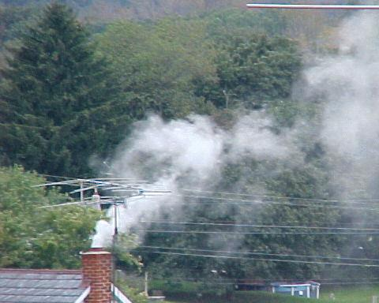
Why do we care about wood smoke?
Fine particle pollution (PM2.5)
6% (382,000 tons) of total PM2.5 direct emissions
Residential wood combustion emits 5 times more PM emissions than all of these combined:
US petroleum refineries
Cement manufactures
Pulp and paper plants
Notes:
More than 8 million home owners use wood stoves to heat their home; 17 million fireplaces in use and more than 240,000 hydronic heaters.

Slide 5
Particles in wood smoke can impact health:
Notes:
Fine particles in wood smoke can impact both the lungs and the heart.

Slide 6
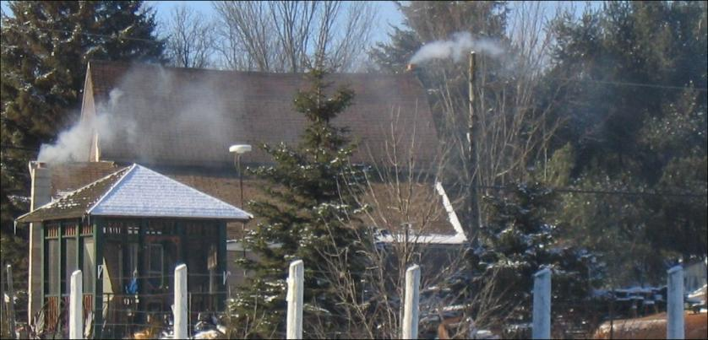
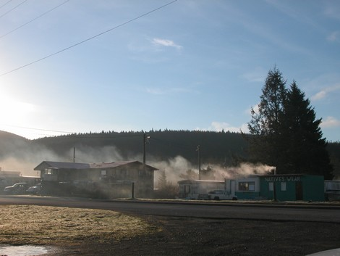
Low stacks
Poor dispersion
Can impact neighbors
and the community
5
Photo: Makah Tribe
Notes:
6
Reminder: emissions are relatively low to the ground
emitted during the winter when air inversions can prevent dispersion of pollution.
.

Slide 7
Revised Standards of Performance for New Residential Wood Heaters

Slide 8
Overview
EPA promulgated revised standards of performance to make new residential wood heaters significantly cleaner than previously required.
Revised standards published March 16, 2015, effective May 15, 2015.
2015 rule broadens applicability of 1988 NSPS, which covered only “room heaters” (adjustable burn-rate wood stoves, fireplace inserts and some pellet stoves) by adding –
Other room heaters --single burn-rate (not adjustable) wood stoves and all pellet stoves; and
“Central Heaters” --wood-fired hydronic heaters (outdoor & indoor wood boilers) and forced-air furnaces (warm-air furnaces).

Slide 9
Overview (continued)
NSPS phases in emission limits in two steps over five years to allow manufacturers time to adapt emission control technologies to their particular model lines.
Compliance with Step 1 emission limits for wood stoves, pellet stoves and hydronic heaters was required by May 15, 2015.
Compliance with Step 1 limits for forced-air furnaces is phased in based on public comments --May 2016 for furnaces less than 65,000 Btu, and May 2017 for furnaces 65,000 Btu or more.
Compliance date with Step 2 emission limits for all regulated wood heaters is May 15, 2020.
Notes:
Bullet 1: Requirements are phased in over 5 years to give manufacturers more time for R&D to comply with the more stringent 2020 emission limits
Bullets 2&3: Emission limits for room heaters are rate-based (grams/hour); central heater limits are based on heat output (pounds PM2.5/million BTU’s of heat output)
Bullet 3: Step 1 limits for forced-air furnaces are the same as hydronic heaters, but furnace manufacturers have more time to comply with Step 1 based on comments received at proposal.

Slide 10
The 2015 NSPS does not…
Apply to existing wood stoves and other wood-burning heaters currently in use in people’s homes.
Regulate masonry heaters.
Apply to fireplaces, pizza ovens, barbecues, chimeneas, fire pits, or new or existing heaters fueled solely by oil, gas, or coal.
Require a specific percent (delivered) efficiency or emissions limit for carbon monoxide, but does require testing and reporting to collect data in case these are required in the future.
Require temporary hangtags.

Slide 11
Wood-Fired Heating Device | Step | Effective Date *after F.R. Notice | Particulate Matter Emission Standard | Test Fuel
Wood stoves & Pellet Stoves (both adjustable and single burn rate) (both catalytic & non-catalytic) | 1 | May 15, 2015 | 4.5 g/hr | Cribwood or Cordwood
 | 2 | May 15, 2020 | 2.0 g/hr | Cribwood
 |  |  | 2.5 g/hr | Cordwood
Hydronic Heaters | 1 | May 15, 2015 | 0.32 lbs/MBtu weighted average AND 18.0 g/hr individual test run cap OR EPA “Phase 2” Qualified | Cribwood or Cordwood
 | 2 | May 15,2020 | 0.10 lbs/MBtu for each burn rate | Cribwood
 |  |  | 0.15 lbs/MBtu for each burn rate | Cordwood
Forced Air Furnaces |  | May 15, 2015 | New work practice and operational standards, including providing information on best operating practices in owner’s manuals | N/A
 | 1 | Small: May 16, 2016 Large: May 15, 2017 | 0.93 lbs/MBtu weighted average | Cordwood
 | 2 | All: May 15, 2020 | 0.15 lbs/MBtu for each burn rate | Cordwood

Slide 12
2020 Voluntary Hangtags
2015 NSPS allows optional, voluntary hangtags to encourage manufacturers to develop cleaner burning residential heaters and to incentivize early compliance with 2020 standards.
EPA issued hangtag guidelines for manufacturers who request them - http://www.epa.gov/burnwise.
To qualify for hangtags, manufacturers should—
Document compliance with 2020 standards for each EPA-certified model
Submit test results showing compliance
Hangtags are temporary and expire May 2020 except models tested with cordwood.
EPA has issued hangtags to four manufacturers (total of 12 wood stove models) and one manufacturer of four hydronic heater models.

Slide 13
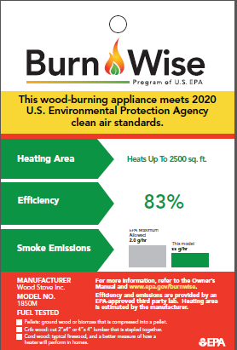
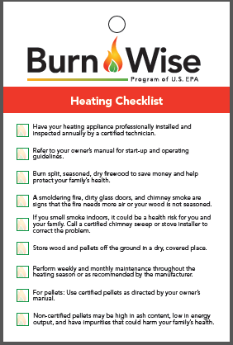
EPA Voluntary Hangtag - Example
Front
Back

Slide 14
Small Entity Compliance Guide May 2015
Assists small business owners who manufacture and distribute new residential woodstoves, pellet stoves, hydronic heaters and wood-fired forced air furnaces.
Outlines compliance responsibilities under the NSPS for each regulated entity.
May be revised in the future to clarify certain provisions of the final rule.
To download a copy: http://www.epa.gov/residential-wood-heaters/small-entity-compliance-guide

Slide 15
Online Database of EPA-certified Wood Heaters
Searchable database of all EPA-certified wood heater models for:
consumers
state/local regulatory agencies
manufacturers and sellers
Expected completion May, 2016
Database to be linked to EPA websites:
Burn Wise
Wood Heater Compliance Monitoring Program

Slide 16
Burn Wise Program
Tools and Materials to Support Woodstove Changeout Programs

Slide 17
Burn Wise Program
Despite success in getting some consumers to choose cleaner-burning appliances, we still see wood smoke issues
Program Goal/Objectives:
To promote responsible wood-burning techniques
Educate users on the connection between what they burn, how they burn and impacts on their health, safety and the environment
Promote safety, savings, and energy efficiency
Do not want to encourage more wood burning, just responsible burning
Notes:
How people burn wood can be just as important as which appliance they use to burn

Slide 18
Supporting Wood-Burning Appliance Replacement Projects
Education and incentive-based (cash rebates) effort to encourage owners of old, inefficient wood burning appliances (e.g.,woodstoves) to “changeout” their stove with a cleaner burning appliance like:
Gas stoves
Wood pellet stoves
EPA-Certified wood stoves
Gas furnaces, heat pumps

Slide 19
Changeout Tools Available
on EPA’s Burn Wise Website
How to Implement a Wood-Burning Appliance Changeout
Program Guide
EPA’s Guide to Financing Options for Wood-burning
Appliance Changeouts
Wood Burning Appliance Replacement Emission Calculator
Does Your Wood Stove have a Dirty Little Secret Brochure
Notes:
Here are tools EPA has developed to help those interested in implementing changeout projects.
The Changeout guide includes steps and lessons learned.
Finance Options guide includes options for funding changeouts. No silver bullets. It includes other federal agencies (DOE, HHS, USDA) program funds that can be used.
EPA is working to build stronger partnerships with other federal agenices.

Slide 20
Burn Wise Messages
Burn the right wood:
Save money and time
Burn only dry, seasoned wood and maintain a hot fire
The right way:
Be safe
Have a certified technician install and annually service your appliance
In the right appliance:
Make your home healthier
Upgrade to an efficient, EPA-approved wood-burning appliance
Notes:
Here is our key message.

Slide 21
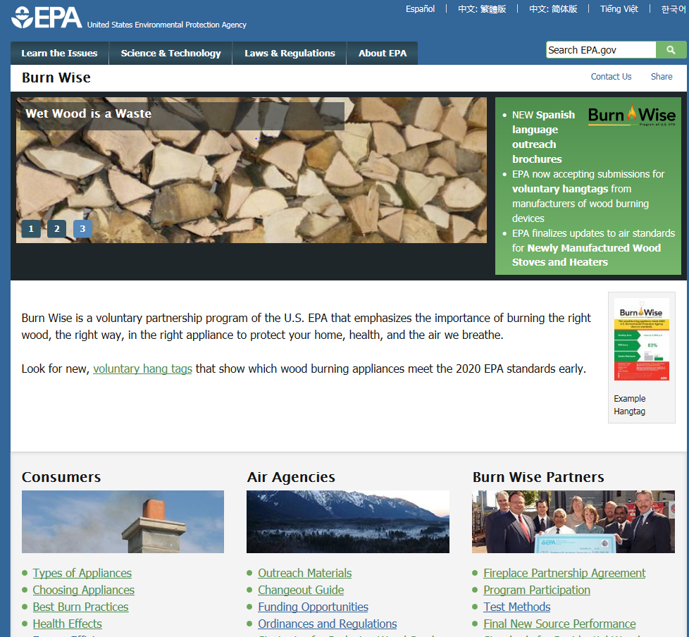
EPA’s Burn Wise Website: www.epa.gov/burnwise
Notes:
Website has an area for Consumer/Wood burners, States/locals and tribes and industry (Partners).
Show of hands, how many have been on our website?

Slide 22
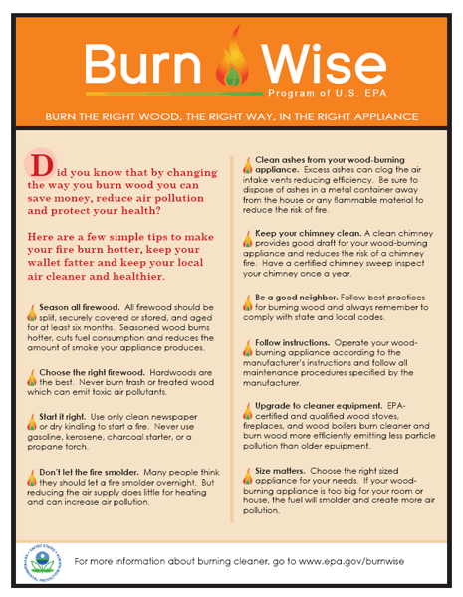
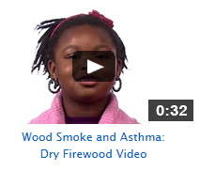
Resources Available:
Outreach Tools
Find online at http://www2.epa.gov/burnwise/burn-wise-outreach-materials
Notes:
We have hard copies that are available for free. You can also take our content and modify it to fit your local needs or message.

Slide 23
EPA Enforcement Settlement Agreements: Wood Stove Changeouts
More than $17 million in funds negotiated
Small ($10K) and larger ($3.1M) projects
Approximately 20 projects located throughout the US
Notes:
Last 5 years this grown, but many larger settlements are winding down.
We encourage you to work with your EPA RO, state or local enforcement office to see about possible for changeout settlement agreement projects.

Slide 24
EPA FY 2015 Targeted Airshed Grants
$7.5 million awarded for wood smoke:
Portola, CA
San Joaquin Valley, CA
West Silver Valley, ID
Grant activities include:
Incentives to changeout old wood burning devices
Education and outreach
Weatherization to reduce heating demand

Slide 25
Changeout and Burn Wise Next Steps
$20 million in Targeted Airshed Grants for FY 2016. Expect changeouts will be substantial part of this funding cycle
Build Stronger Partnerships with other Federal Agencies (US Department of Agriculture, Health and Human Services)
Notes:
Bullet 1: HHS’s Low-income Home Energy Assistance has the ability to fund changeouts.
Bullet 2: We believe there is a need to raise awareness about the health effects of wood smoke.
Bullet 3: We are trying empower homeowners to test their own fire wood to see if it is dry and ready to burn (i.e., <20 % moisture content). Meter’s cost about $20 - $30.
Bullet 4: More needs to be known about the benefits of reducing wood smoke ( less Black carbon and methane) to see how that impacts the climate.
Hope to

Slide 26
Questions?

