Slide 1
Calculating Energy Efficiency Using A Chemical Mass Balance Method
Crispin Pemberton-Pigott
Reporting research on the combustion of solid fuels conducted at
SeTAR Centre, University of Johannesburg
Cape Peninsula University of Technology, Cape Town
China Agricultural University, Beijing
Presented at
Brookhaven National Laboratory – 7 April 2016

Slide 2
Problem Statement
=Test methods assume that the fuel burns and dries
homogeneously
If this was true there would not be a
“char-burning phase”
Emissions and efficiency are miscalculated because of this assumption

Slide 3
Energy Efficiency:
An efficiency is a ratio:
Useful Energy Delivered . X 100%
Energy available in the fuel consumed
Consumed: Combusted to the point where remainder is abandoned

Slide 4
Energy Efficiency:
An efficiency is a ratio:
Useful Energy Delivered . X 100%
Energy available in the fuel consumed How is this determined?
Consumed: Combusted to the point where remainder is abandoned

Slide 5
Fuel Analysis – MASHCON
M Moisture
A Ash
S Sulphur
H Hydrogen
C Carbon
O Oxygen
N Nitrogen
HHV Higher Heating Value

Slide 6
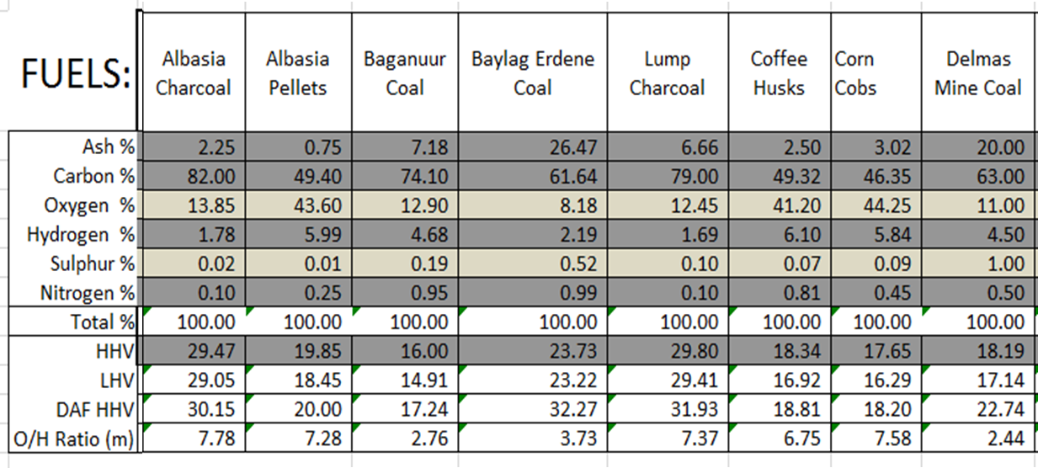
Fuel Analysis – MASHCON – Examples
Ultimate analysis (dry) in a mass basis

Slide 7
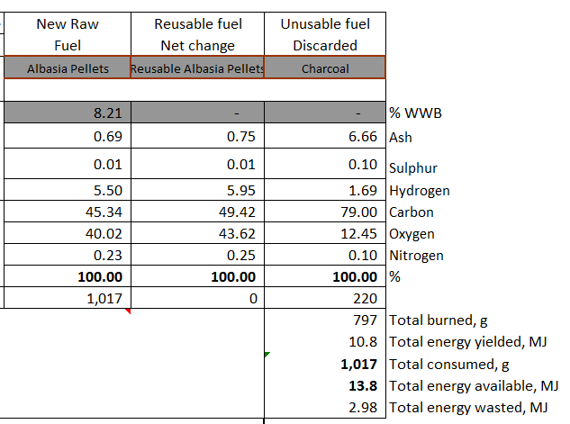
Fuel Analysis – MASHCON – Multi-fuel
Determination of the fuel composition can be challenging

Slide 8
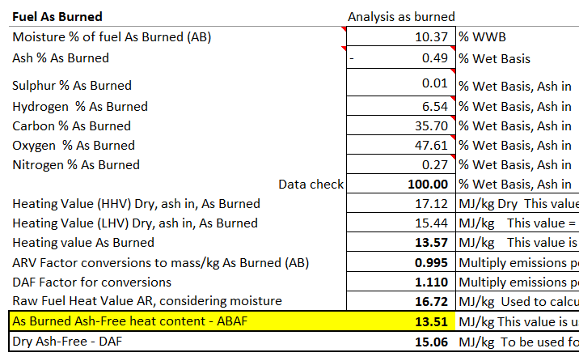
Fuel Analysis – MASHCON
Determination of the fuel composition can get complicated II
As Burned Ash-Free heat content - ABAF

Slide 9
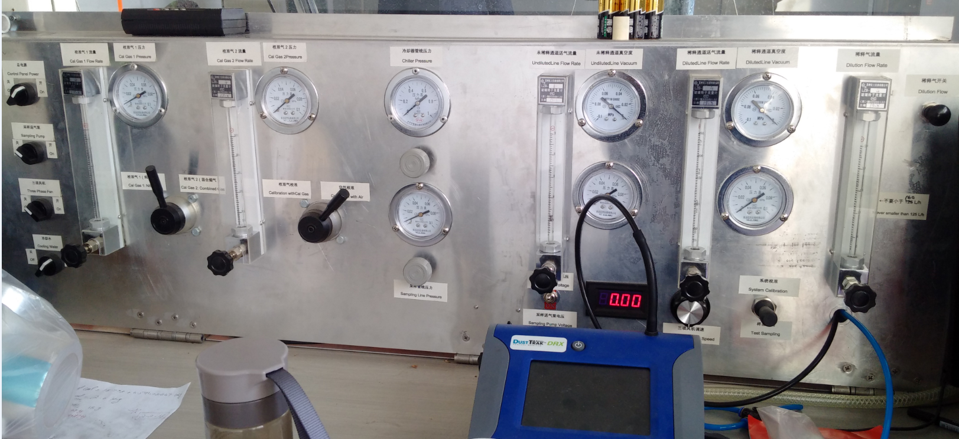
Collect the Products of Combustion
Tracking the combustion is challenging too B.E.S.T. Lab, CAU College of Engineering

Slide 10
Heat Gained – Space Heating
Calculate what energy was available in the fuel
Calculate the losses up the stack
Siegert Method – estimates losses up the stack
Gas-by-gas calculation – estimate losses up the stack
Heat Gained, by subtraction

Slide 11
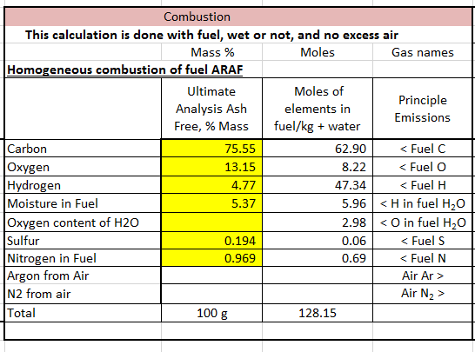
Step 1: Combust the Fuel
Remove the ash and convert to Molar Elements

Slide 12
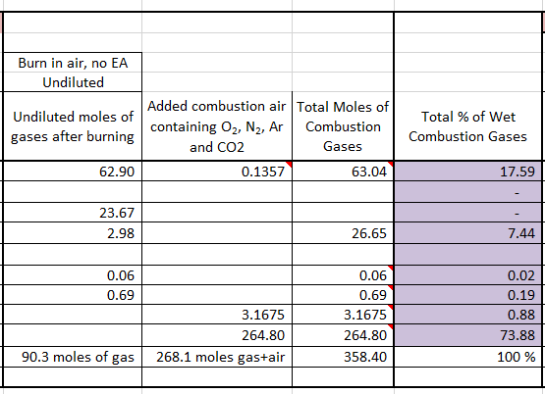
Step 1: Combust the Fuel
Combust in Air
Water Vapour 74,000 ppm

Slide 13
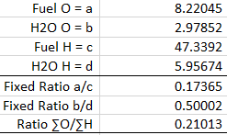
Assumptions
1. Hydrogen and Oxygen are present in the Fuel and Water in known ratios
Fuel O and Fuel H are released homogeneously from biomass even if the
fuel burns inhomogeneously

Slide 14
Assumptions
1. Hydrogen and Oxygen are present in the Fuel and Water in known ratios
Fuel O and Fuel H are released homogeneously from biomass even if the
fuel burns inhomogeneously
All three are simultaneously true

Slide 15
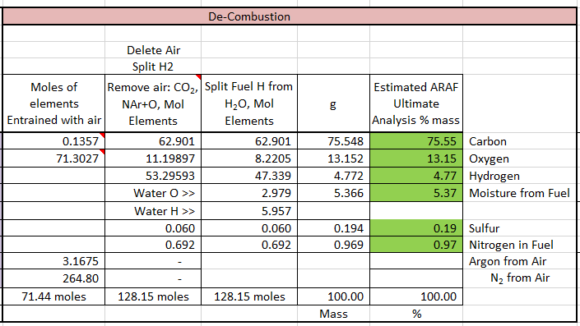
De-combustion

Slide 16
De-combustion
Check for a fuel moisture deficit or surplus
The HHV of this “fuel” is used in the denominator of the Efficiency calculation

Slide 17
Significance of Real-Time Fuel Analysis
The HHV can be calculated in real time as the fuel evolves
The CO_{2MAX} value can be calculated in real time

Slide 18
Significance of Real-Time Fuel Analysis
The HHV can be calculated in real time as the fuel evolves
The CO_{2MAX} value can be calculated in real time
The ratio of the oxygen provided by air to the total oxygen demand can be determined in real time [StOxR]

Slide 19
Significance of Real-Time Fuel Analysis
The HHV can be calculated in real time as the fuel evolves
The CO_{2MAX} value can be calculated in real time
The ratio of the oxygen provided by air to the total oxygen demand can be determined in real time [StOxR]
The stoichiometric volume of combustion gases can be calculated using StOxR.
From this the diluted volume of gases can be calculated using the Excess Air level.
The concentration of pollutants in that volume can be determined.

Slide 20
Significance of Real-Time Fuel Analysis
The HHV can be calculated in real time as the fuel evolves
The CO_{2MAX} value can be calculated in real time
The ratio of the oxygen provided by air to the total oxygen demand can be determined in real time [StOxR]
The stoichiometric volume of combustion gases can be calculated using StOxR.
From this the diluted volume of gases can be calculated using the Excess Air level.
The concentration of pollutants in that volume can be determined.
The mass of emissions can be reported more accurately per measurement interval.

Slide 21
Why is this an improvement?
Two different approaches can be made:
1. Assume the fuel burns and dries homogeneously
Assume this is not the case but that the Oxygen and Hydrogen are released
from the fuel homogeneously
The Chemical Mass Balance assumptions provide an analysis that more closely represents what is actually happening in a solid fuel fire.

Slide 22
Why is this an improvement?
Two different approaches can be made:
1. Assume the fuel burns and dries homogeneously
Assume this is not the case but that the Oxygen and Hydrogen are released
from the fuel homogeneously
The Chemical Mass Balance assumptions provide an analysis that more closely represents what is actually happening in a solid fuel fire.
Fuel O to Fuel H
Water O to Water H
Measured ∑O to Measured ∑H

Slide 23
Thank you!
Appreciations:
Staff and graduate students at:
The SeTAR Centre, Research Village, University of Johannesburg, Department of Geography, Environmental Management and Energy Studies, JHB, R.S.A.
Chinese University of Agriculture, College of Engineering, Beijing, China
Cape Peninsula University of Technology, Cape Town, R.S.A.
This work represents personal efforts and was not funded.

Slide 24
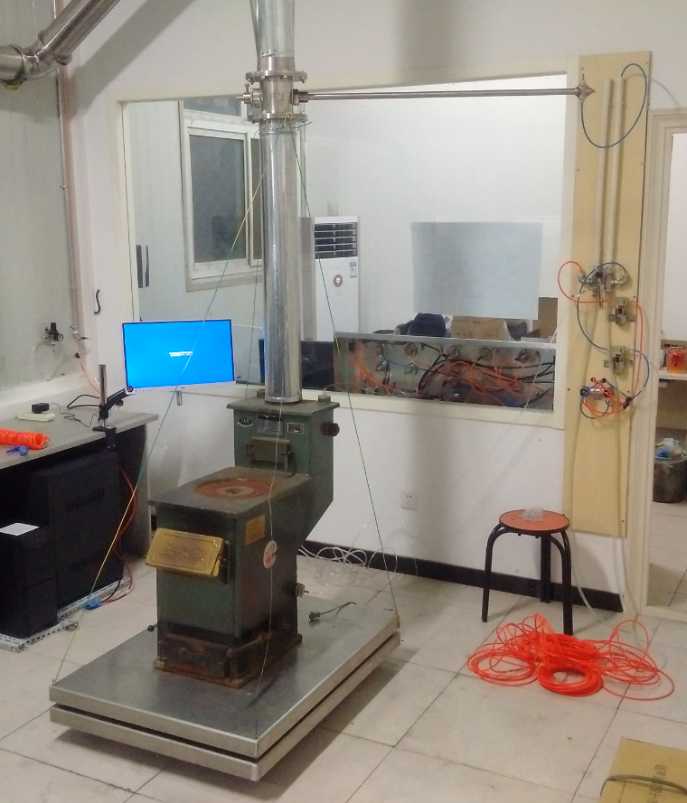
Bishkek, Kyrgyzstan 2016 Haidian North, China 2016

