Slide 1
Development of the VibraStove
How I stumbled into the NYERDA event at Brookhaven National Lab

Slide 2
The seed was planted three winters ago.
First, I “discover” the Rocket Stove. It was love at first sight, couldn’t get “her” out of mind.
I was obsessed with the beauty of the stove’s simplicity.
But she (it) needed a little improvement here and there.
I gladly accepted the challenge.

Slide 3
Make my first 55 gallon barrel Rocket Stove
Used it to heat a garage and small office during a bitter cold winter.
The next winter I make a small 5 gallon version to heat my home.
I didn’t like have to constantly feed it wood
Decide to switch to pellets to avoid the problem.
Proceeded to smoke up my house most of that winter. My wife got sick from the smoke.
On many occasions I’d run an exhaust fan out the upstairs window.
Love nice cold air pouring in the open kitchen door in the dead of winter.

Slide 4
Discovered dozens of ways that pellets won’t feed by gravity or by automation.
Somehow we survive that first winter.
Spring arrives, we jerk out the stove and I start building new ones.
My shop consists of my back porch and back yard.
Build 20 different working prototypes from spring to fall.
Day and night, building stoves. Burning them late into the night.
Burning more pellets in the summer than in the winter.
By the fall of 2015 I’ve got the stove I’d been looking for.
Install the new model in the kitchen.

Slide 5
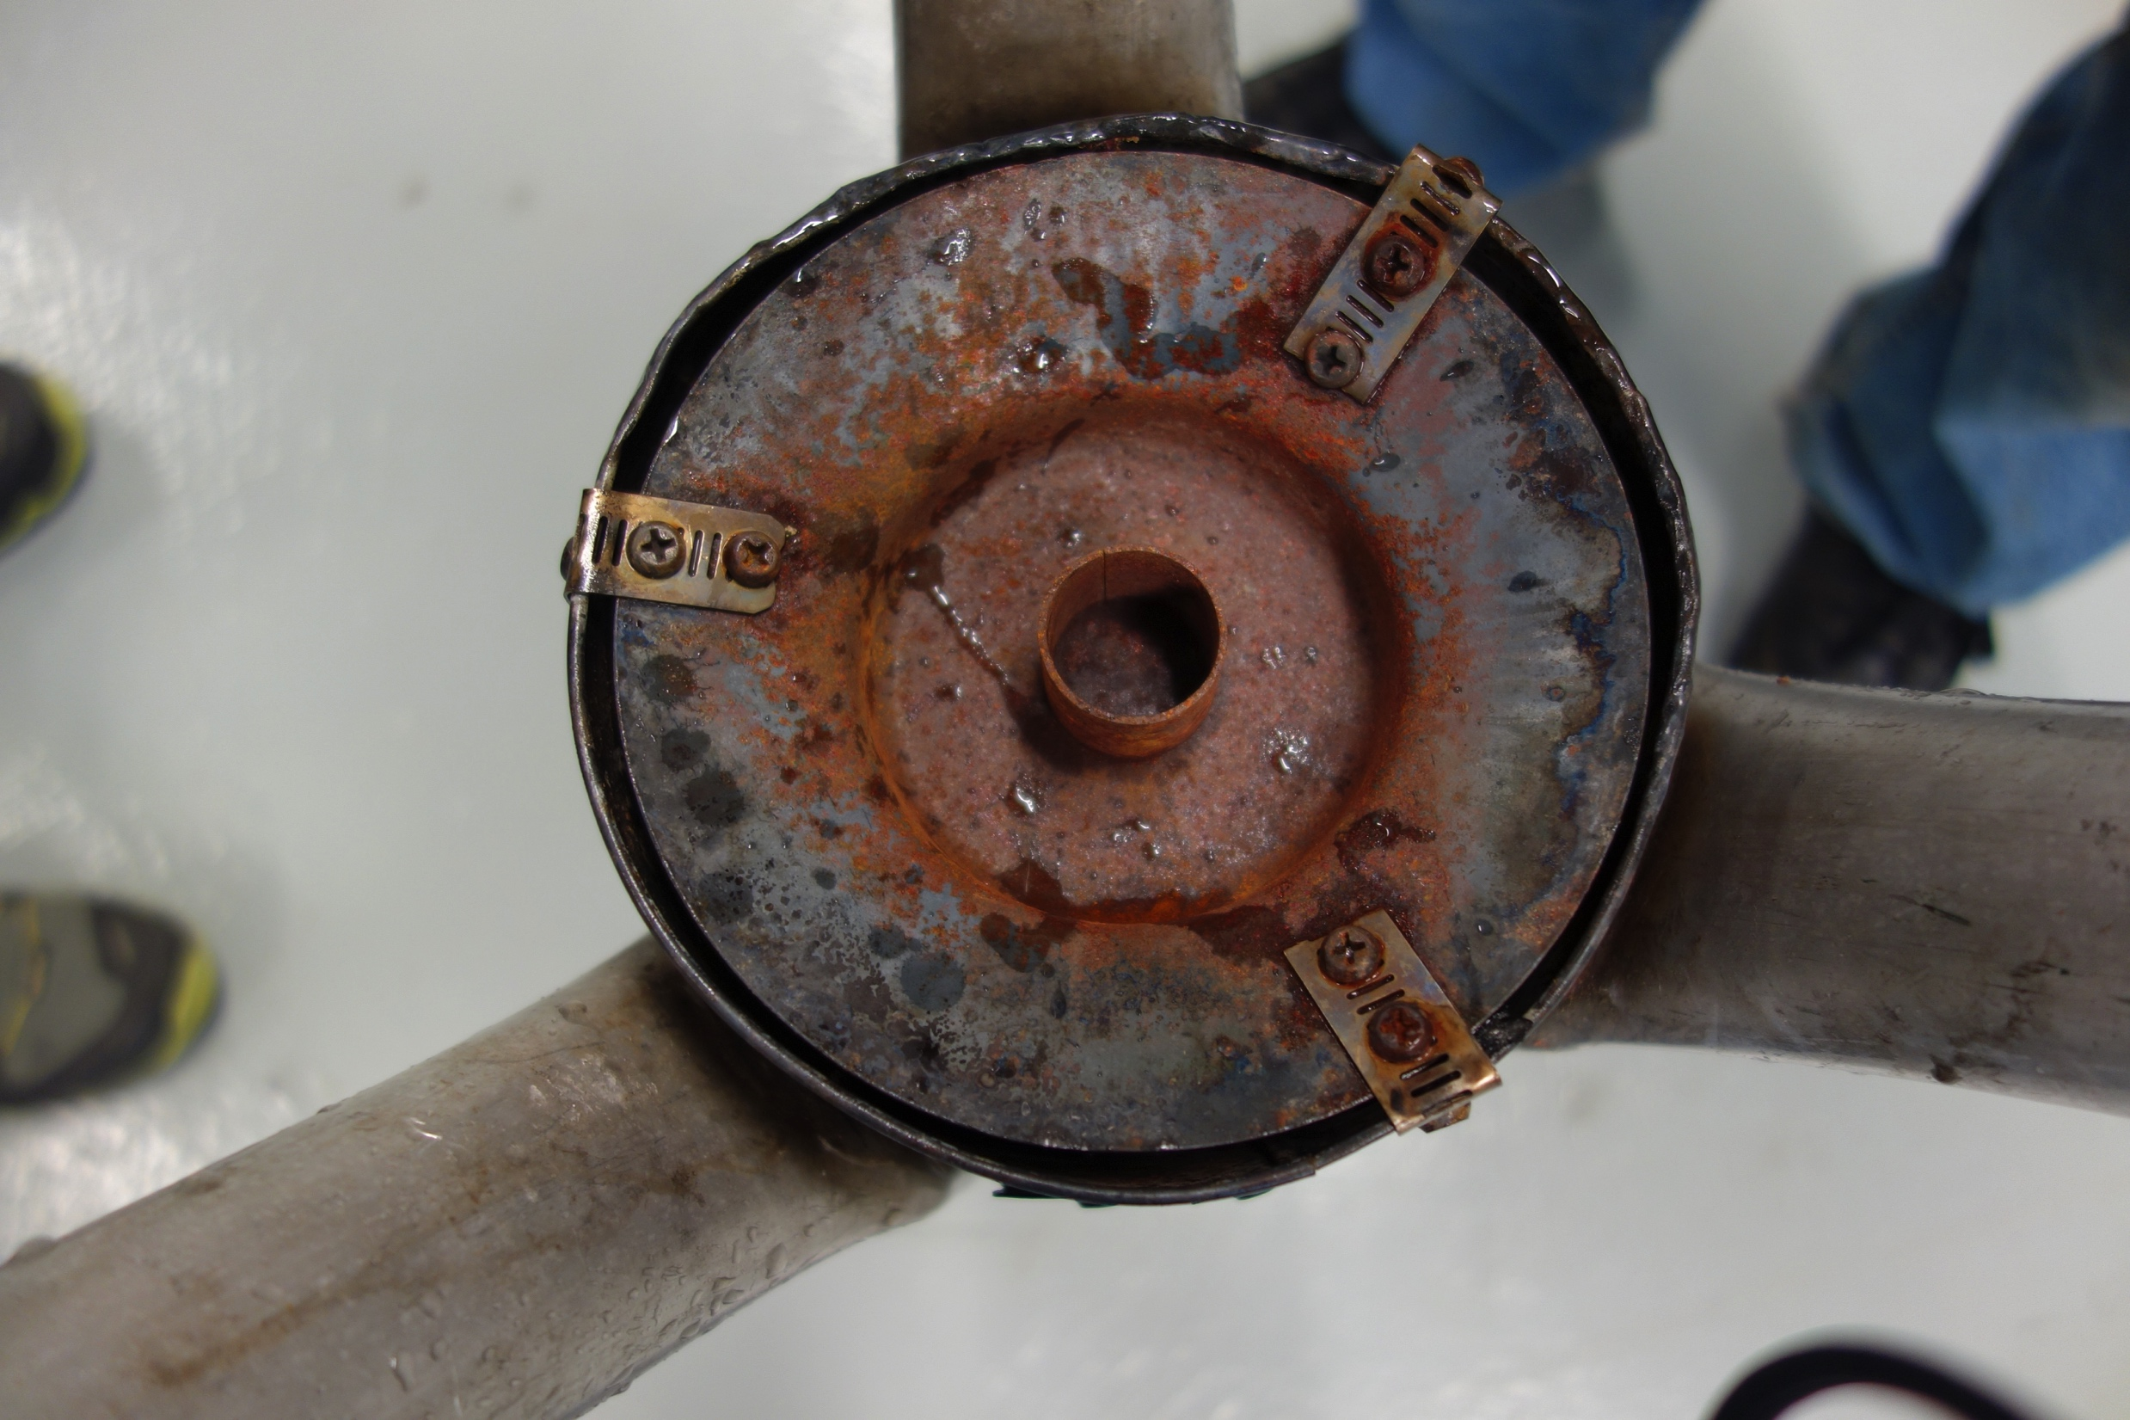
Confident this one will work without smoke.
Had the propane company pick up one of their two tanks.
I purchase my first ton of pellets.
We’re gonna heat with pellets this year.
First cold fall day I fire up the new and improved stove.
Could you imagine, it started to smoke, just like the others?
Out goes the stove to the back porch (welding shop).
I cut off the “smoking” fuel hopper.
Quickly devise a replacement, and install it, untested.

Slide 6
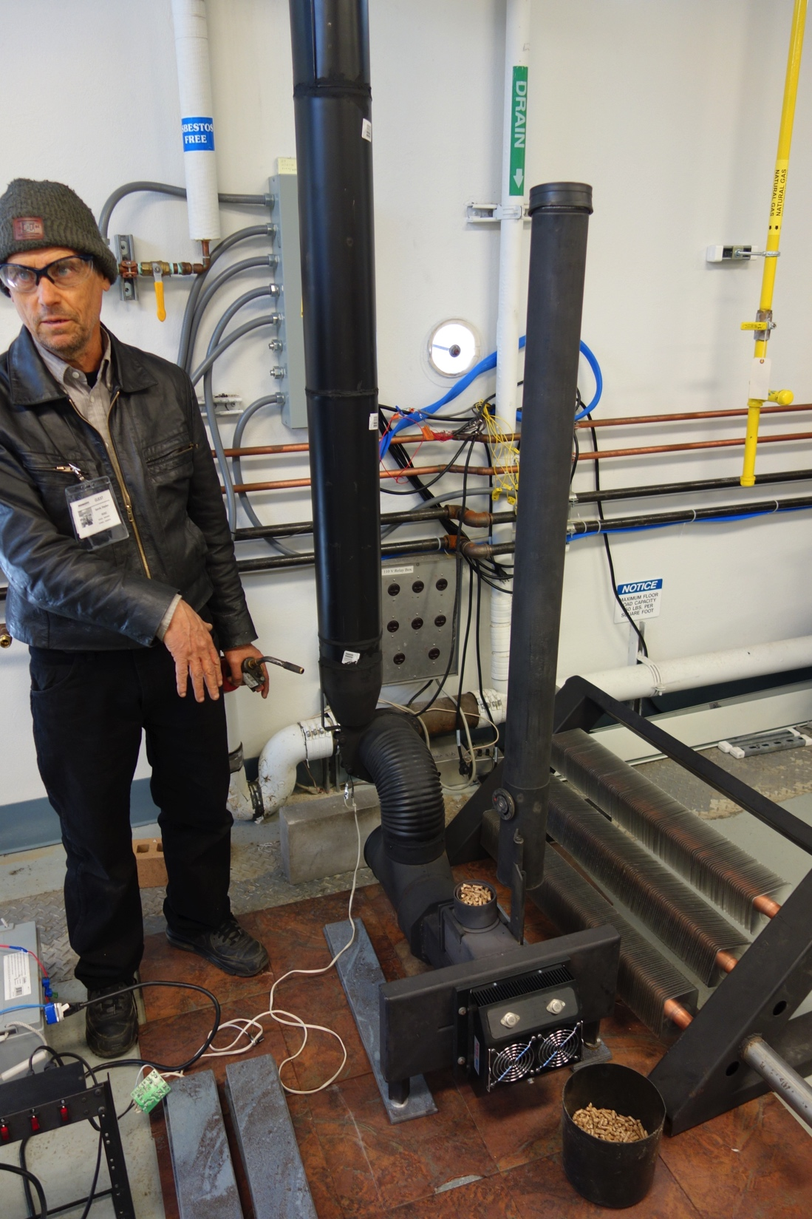
Light up the “new stove” with new “hopper”
No smoke. Day one. No smoke, night one.
No smoke, week, one, no smoke, month one.
No smoke months two thru four.
This thing don’t smoke.
No smoke in the house, and no smoke in the chimney.
I’d say this stove has kicked the habit.
So I get to thinking.
Maybe someone else might like a stove that don’t smoke.

Slide 7
Internet search time.
Hello Alliance for Green Heat
Guess what? They’re looking for non-smokers.
Two weeks before the deadline I submit an application for the contest
They come and test the stove. No smoke makes good numbers.
I’m in.
That’s how I got here, you may say, by accident.

Slide 8
What is different about this stove?
Best described as part mini-blast furnace, part mini-incinerator
Combined with gasification, and gravity feed pellets
Picture yourself making a small camp fire.
You start with a small careful fire. Increasing it bit by bit
Then once it begins to flare up you take all your fuel and dump it
You completely cover the fire with unburnt fuel, so to smother it
But not so with the VibraStove. You can’t put the fire out with fuel
Close coupled combustion is immune to oxygen starvation

Slide 9
The “Trick” is where the oxygen enters
There is a 360 degree “flame ring” at the bottom of the fuel hopper
Outside air is down drafted into ring of fire
The amount of fuel above the ring of fire is irrelevant
The burn zone burns an arch into the fuel above it.
The arch continually collaspes, suppling new fuel to the burner
The red hot fire zone gasifies the solid fuel above it.
The pellets are turned into charcoal.
The charcoal feeds the fire

Slide 11
Next: Make it off-grid friendly
Only one moving part, the exhaust blower
Max power 8 watts, idles at around 3 watts
Installed a 30 TEG, Thermoelectric generator
TEG charges battery, battery runs blower
No sensors, no controller, no auger or motor
Low low tech
Simple, low cost materials. Stock metal shapes.
Low temp exhaust, no need for expensive chimney

