Slide 1
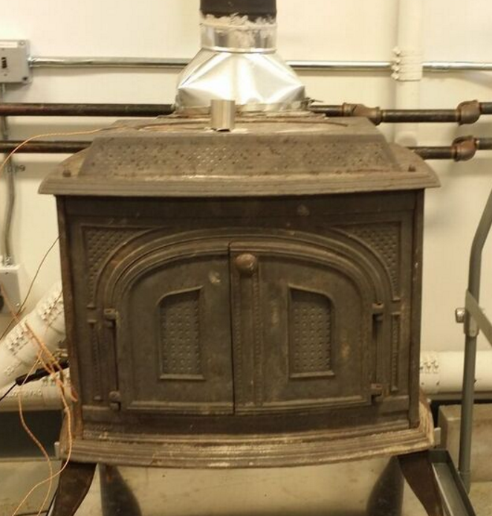
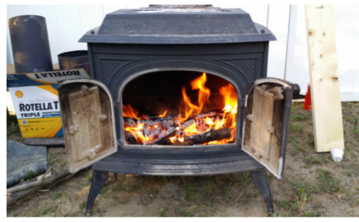
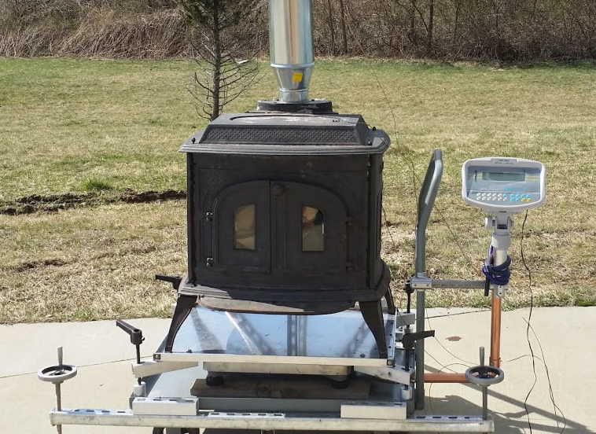
The “Lumburnator” a Next Generation Wood Stove
Student Team:
Jake Lindberg, JinYing Lin,
Kevin J. Lee, Yunxiao Jiang, Jason Peng
Advisors:
Dr. Devinder Mahajan, Dr. Jon Longtin, *Dr. Vladimir Zaitsev,
Dr. Tom Butcher (BNL)

Slide 2
Introduction
*According to the EIA Winter Fuels Report:
• Wood as primary heat up by 33%
• 2.6 million home’s primary heat
• 9.8 million home’s secondary heat
**EPA expects 113,000 wood stoves to be sold in 2015
**Mandates by 2020:
• 2.5 g/hr PM_{2.5}
• 70% reduction in VOCs
• 62% reduction in CO
*"Short Term Energy Outlook (STEO)." Energy Information Administration - EIA - Official Energy Statistics from the U.S. Government. N.p., 8 Mar. 2016. Web. 6 Apr. 2016.
**Standards of Performance for New Residential Wood Heaters, New Residential Hydronic Heaters and Forced-Air Furnaces. Rep. 50th ed. Vol. 80. N.p.: EPA - Environmental Protection Agency, n.d. 16 Mar. 2016. Web. 6 Apr. 2016.

Slide 3
Scope of Work
• Subtask 1.1 Design and Fabricate Firebox
• Subtask 1.2 Propane burner system
• Subtask 1.3 Airflow Design
• Subtask 1.4 Completion of the Year One Lumburnator
• Subtask 1.5 Participate in 2016 Design Challenge
**Subtask 2.4 Onsite Testing

Slide 4
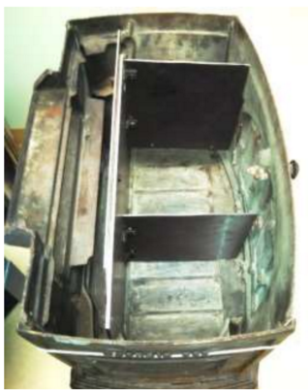
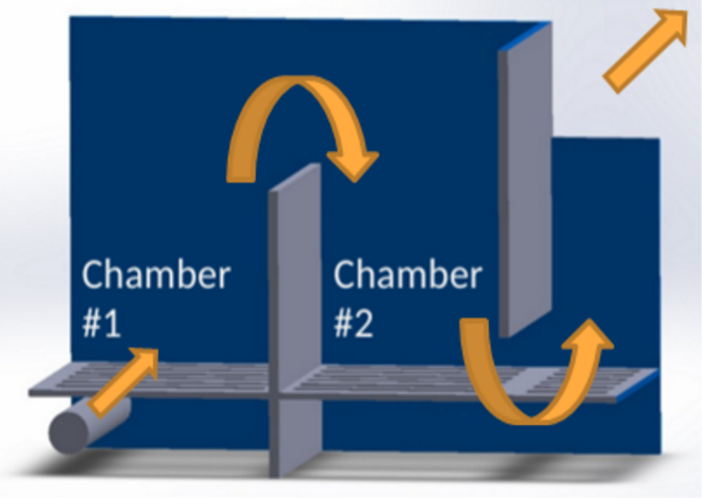
The Firebox
Firebox Dividers:
• Separate fuel charges ➡ reduction in Burn Rate (BR)
• Increase residence time and turbulence
Dual chamber system:
• Thermally oxidizes emissions
• Enables staged combustion

Slide 5
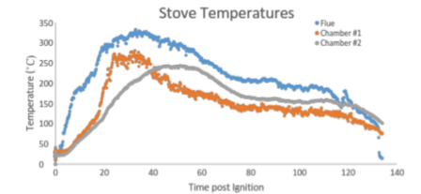
Intermediate Results...

Slide 6
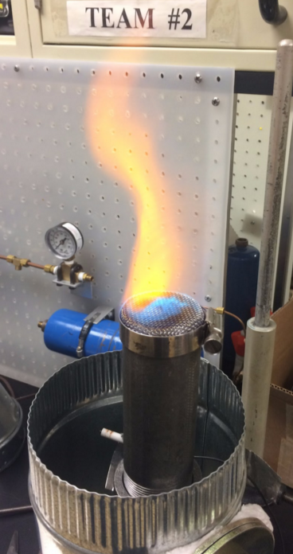
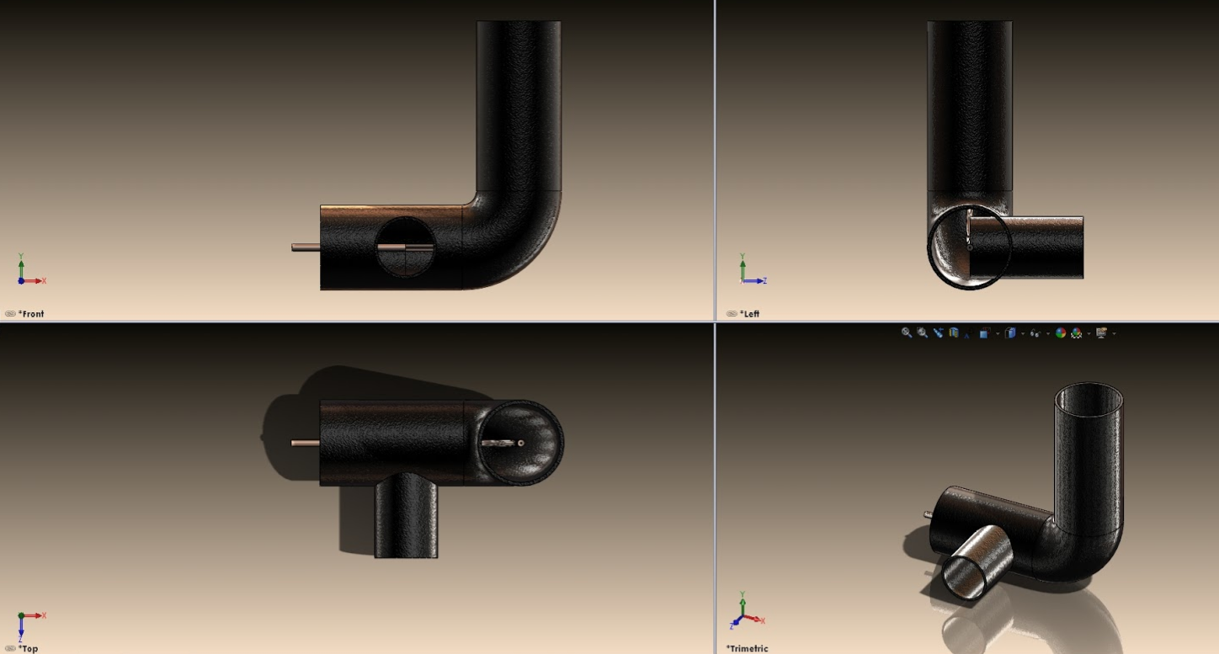
Afterburner
• Propane fired afterburner thermally oxidizes VOC and CO
• Effective during pre-burn
• Propane can be used for push-button ignition

Slide 7
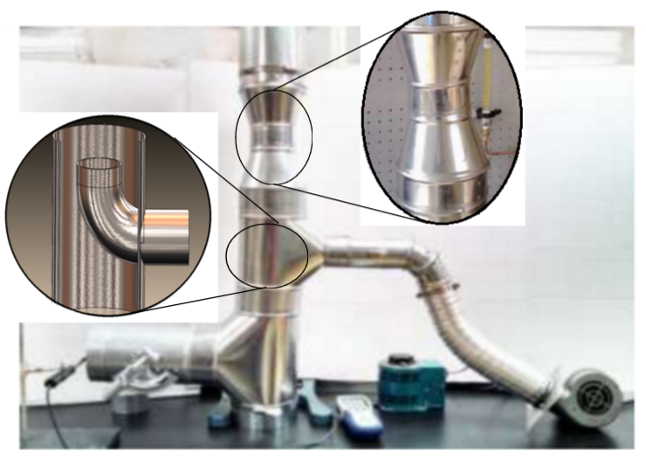
The Airflow System
• Draft Control ➡ BR control
• Enables electronic process control
• Induction results in dilution and cooling of flue gas
- Dilution important for
measurement systems
- Cool gas needs means
smaller chimney
Venturi Draft Inducer

Slide 8
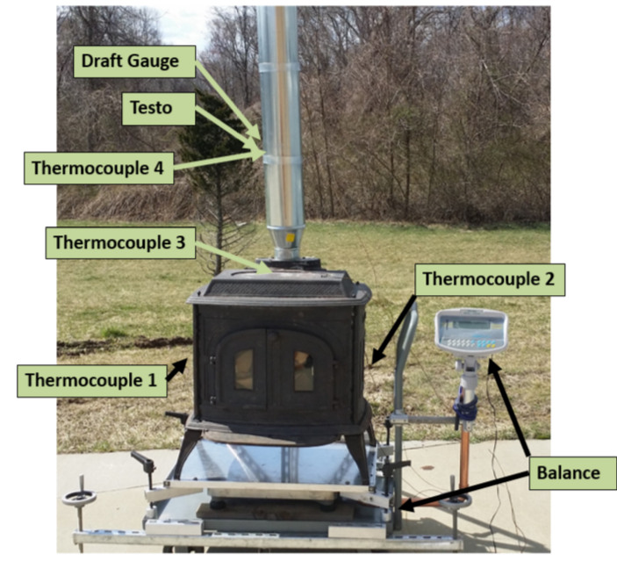
Setup
• Scale ⇾ burn rate evaluation
• Anemometer ⇾ draft/dilution ratio measurements (CV)
• Draft Gauge ⇾ draft changes (PCV)
• Thermocouples – location specific temperatures (PCV)
PCV = process control variable
CV = control variable

Slide 9
Future Work
Subtask 2.1 Catalytic Combustion
Subtusk 2.2 Control system
Subtask 2.3 Ignition System
**Subtask 2.4 Onsite Testing
Subtask 2.5 Participate in 2017 Woodstove Design Challenge

Slide 10
Thanks!
With special thanks to NYSERDA and Robert Carver, Brookhaven National Laboratory and Dr. Tom Butcher, Stony Brook University and professors Devinder Mahajan, Sotirios Mamalis, Benjamin Lawler, and Jon Longtin.

Slide 11
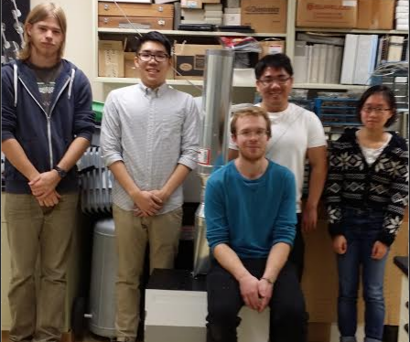
Questions?
Student Team Photo

